Slide 1
Chinese Language club
Officially certificated club by Waseda Univ.

Slide 2
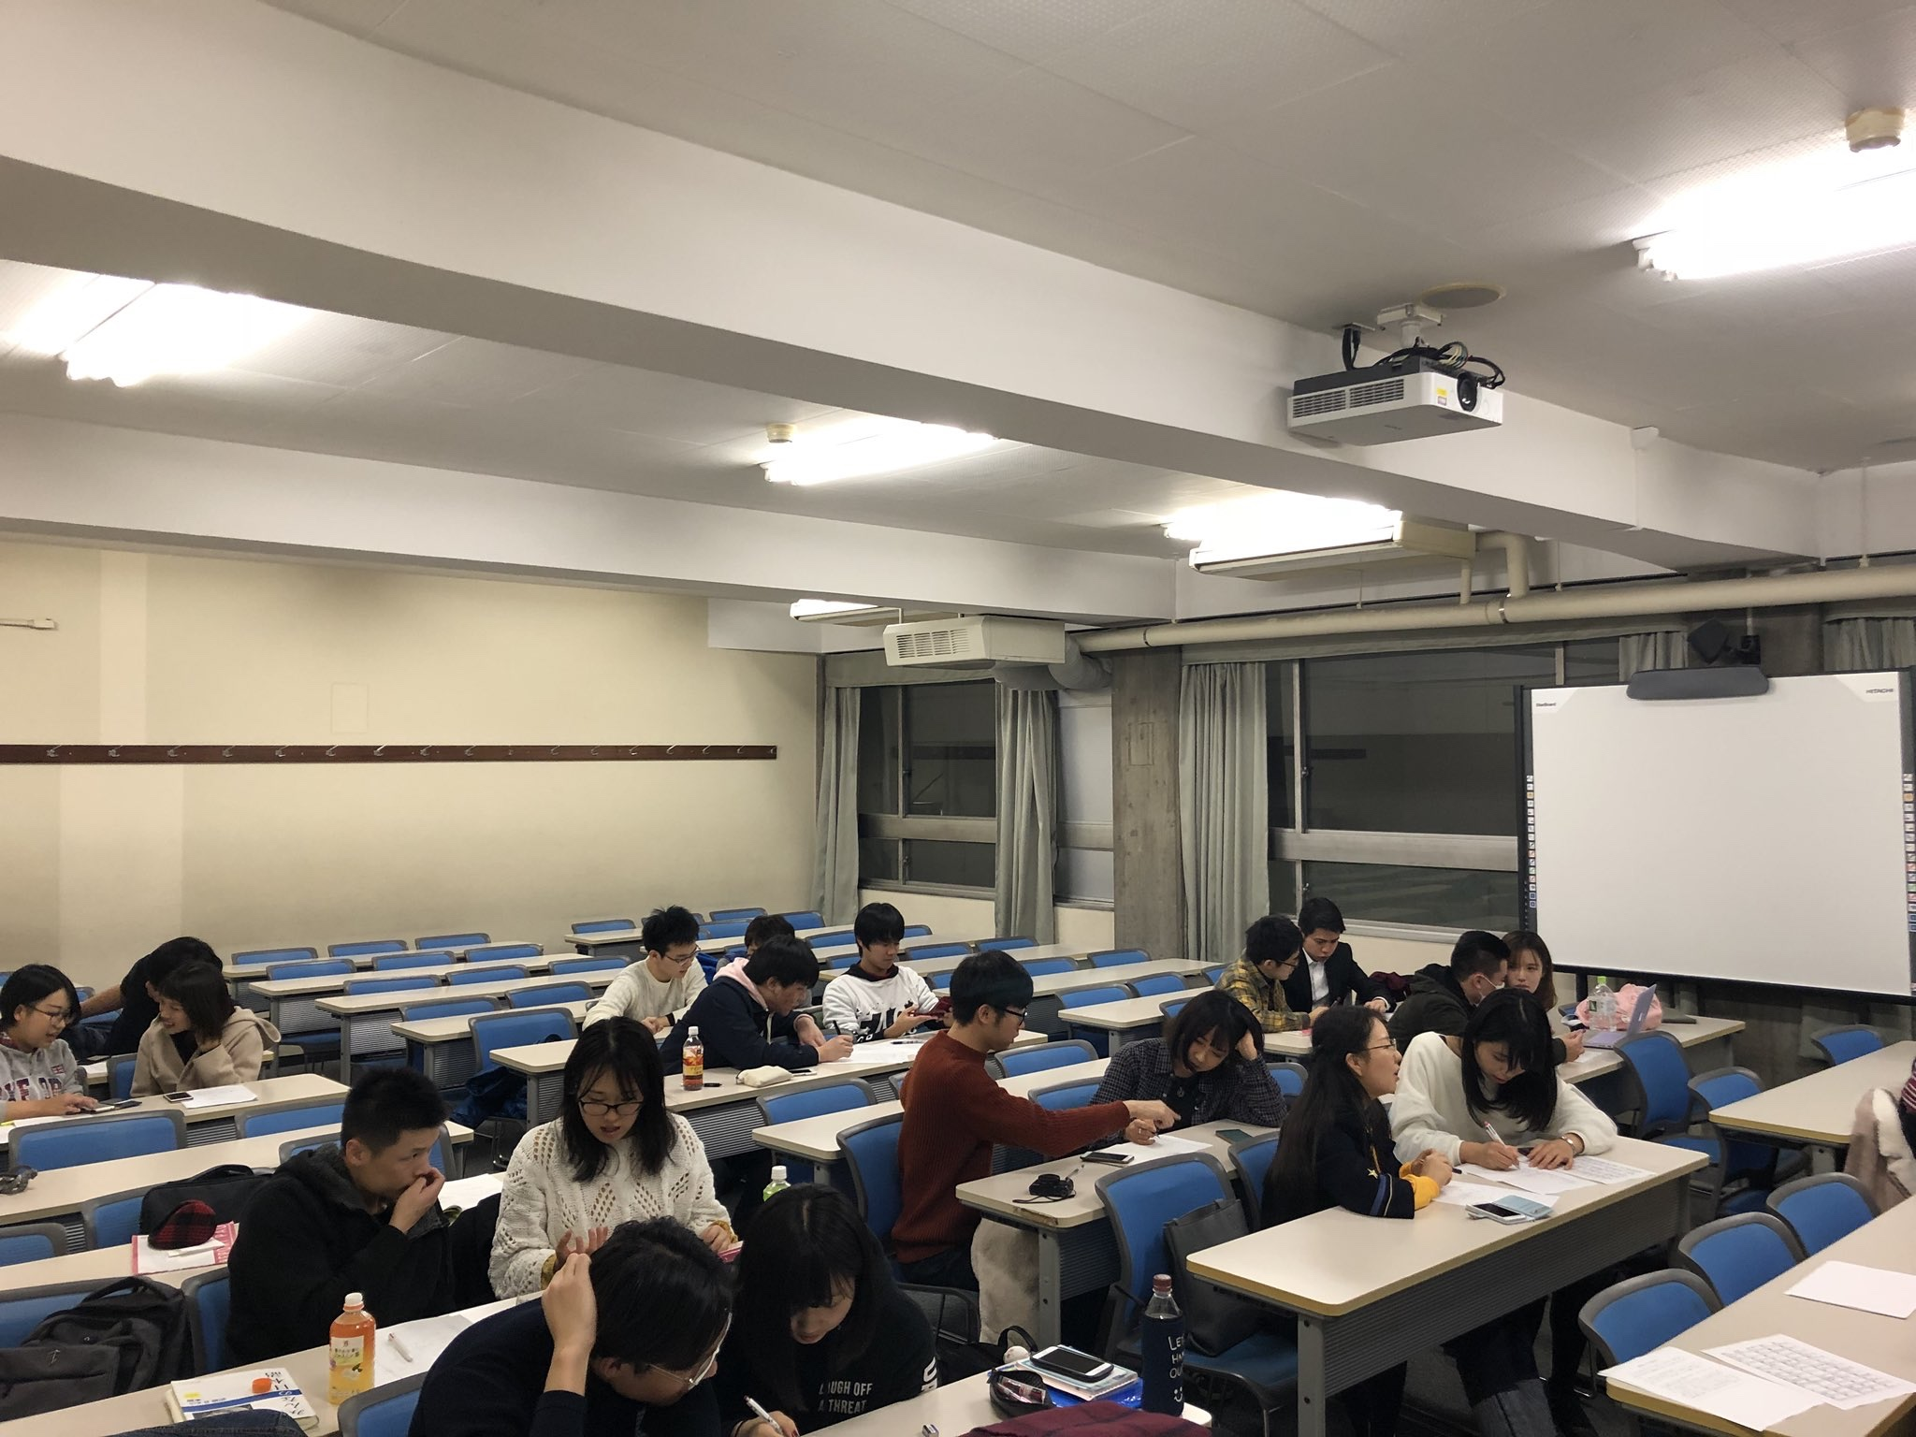
Main Activity
Spring semester we changed into online activity because of COVID-19.
Our staff match students who want to learn Chinese or Japanese and teach each mother language.
In addition, we plan to hold the cultural exchange meeting through Zoom.
Club Fee: Free (this year)

Slide 3

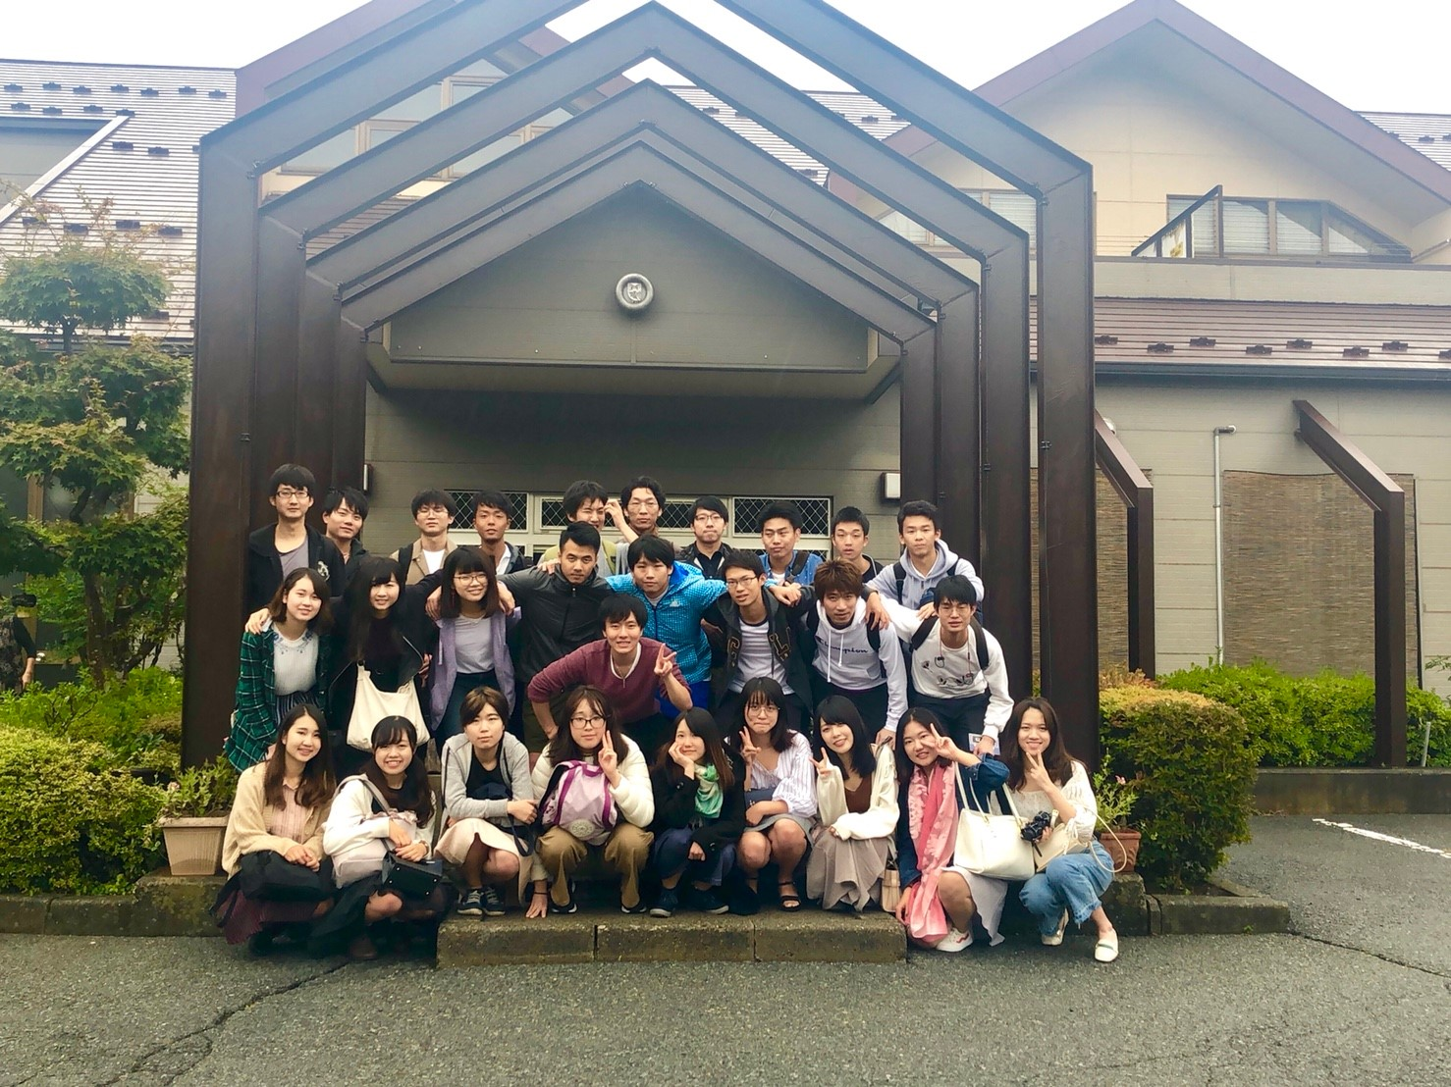
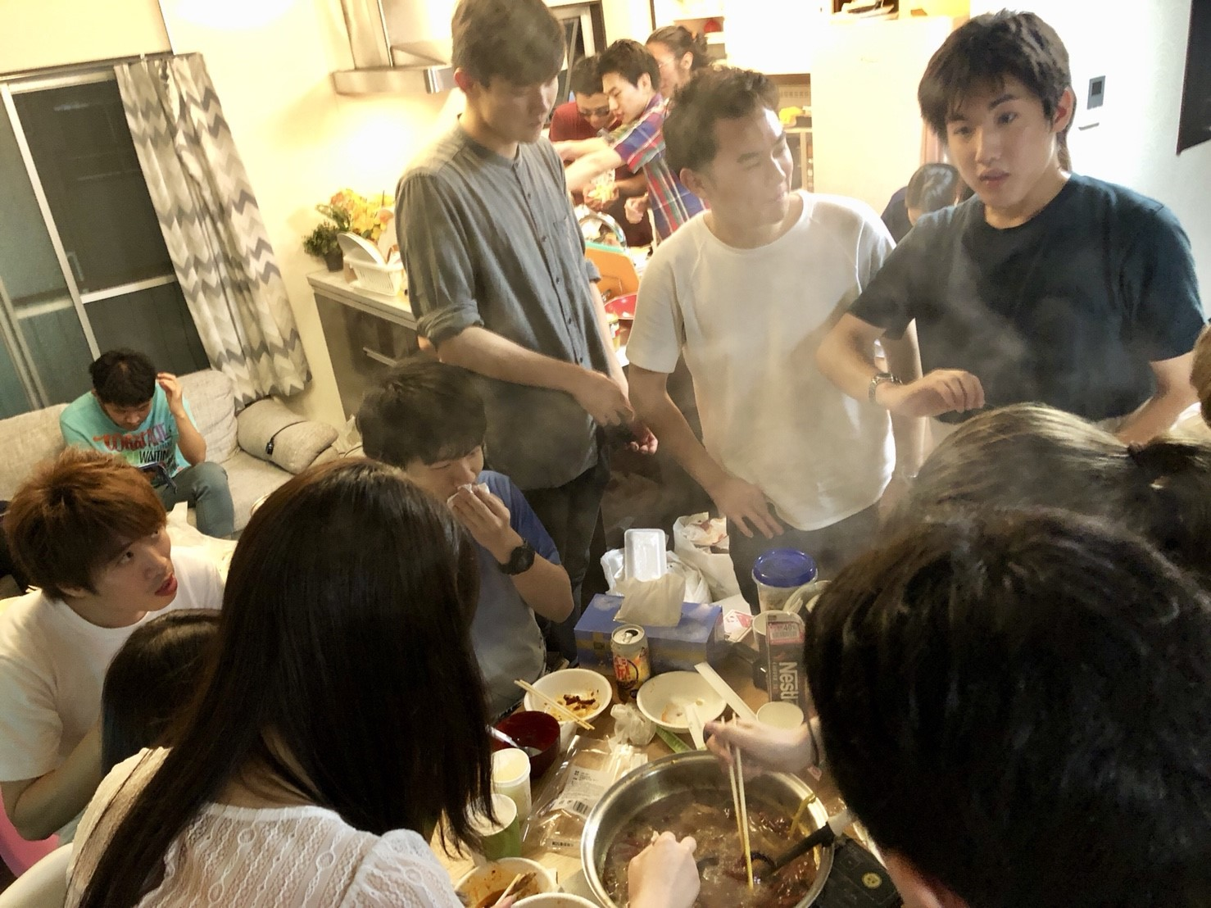

There are many events!
On the other side, Chinese cooking party, Bowling and vacation trip.
※Last spring semester we didn’t hold any events as following the Univ’s rule.
Summer trip
In Yamanashi
Cooking party

Slide 4

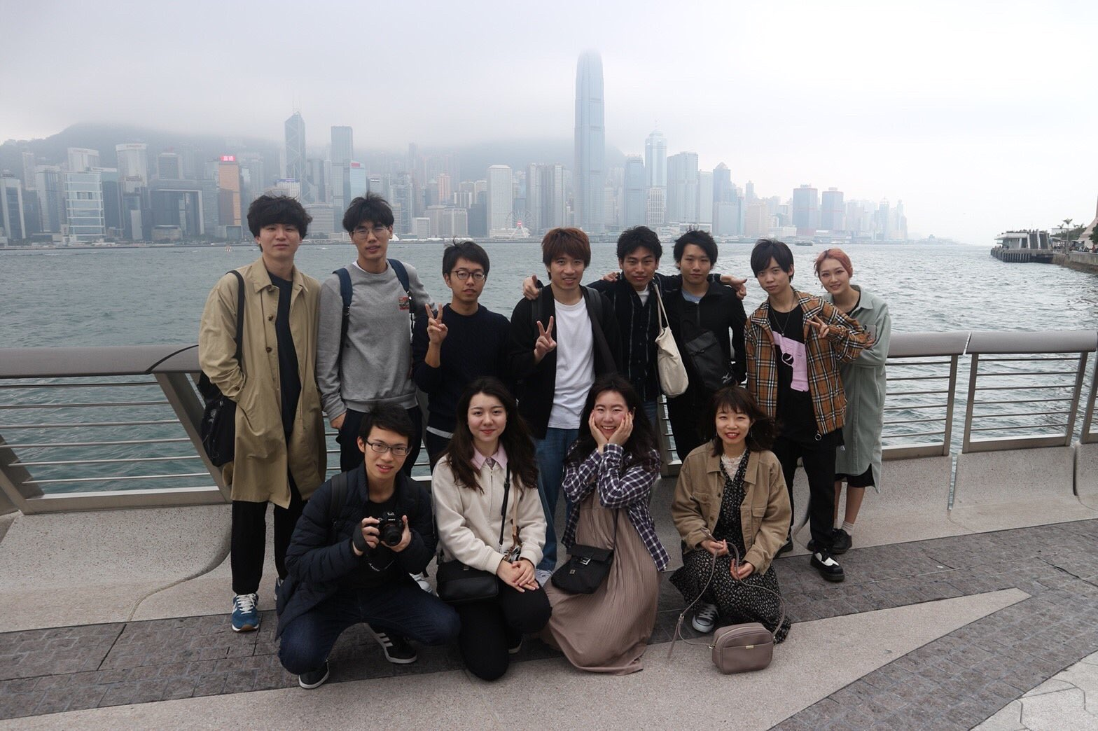


Also we have foreign trip
2019’s February we went to Hong Kong, in the past, we went to Shanghai and Beijing.

Slide 5
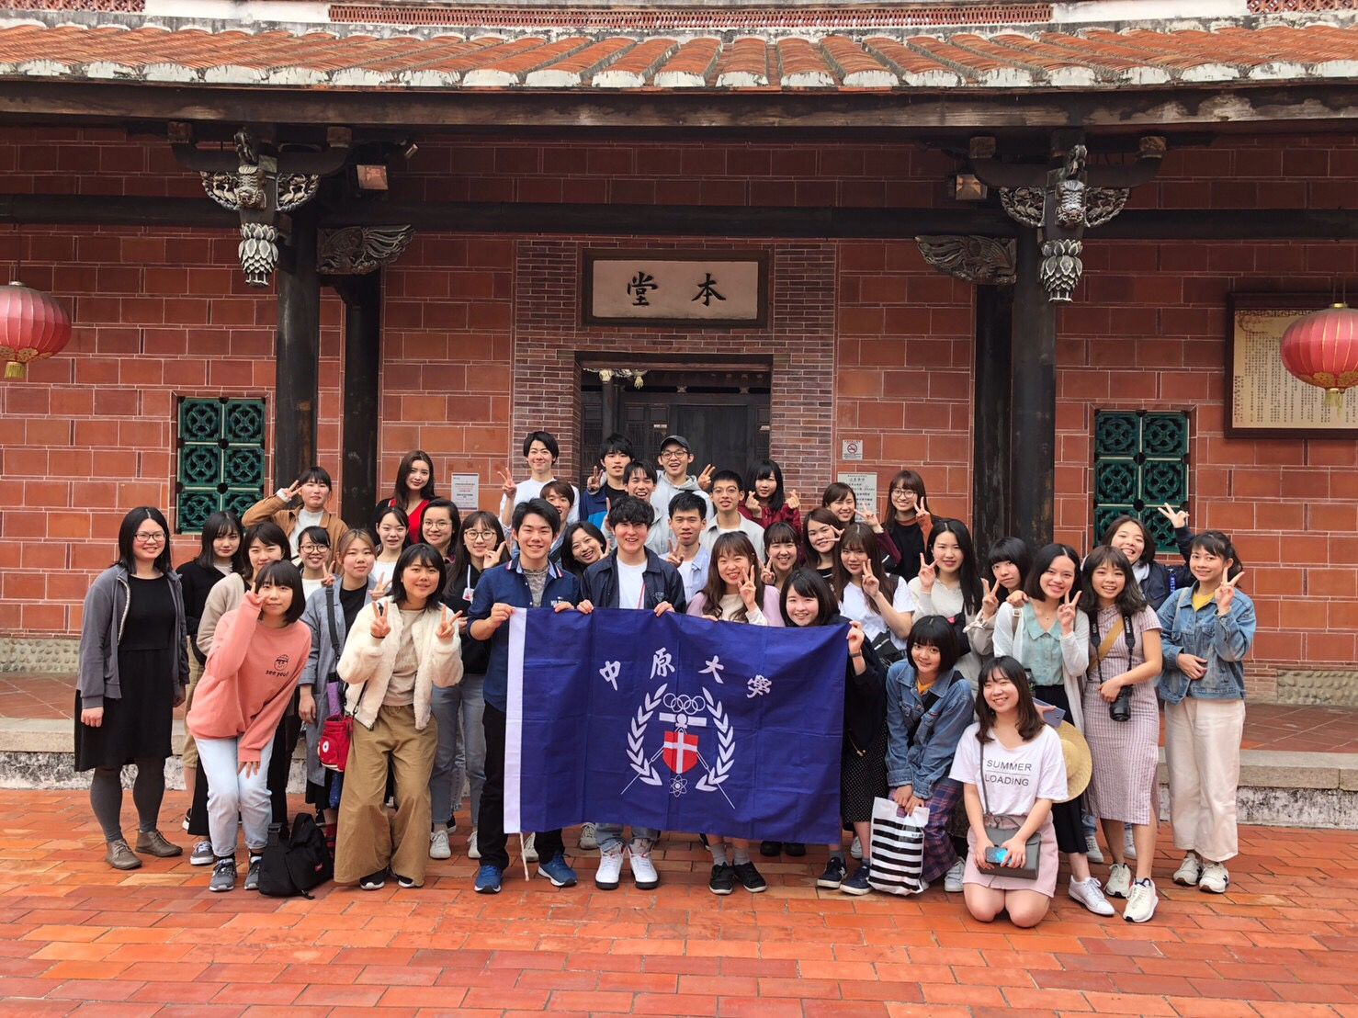
Many members experienced studying abroad
Most of us plan or have experienced to learn in China, Taiwan or Hong Kong.
・Peking Univ
・Zhejiang Univ
・Fudan Univ
・National Taiwan Univ
・National Taiwan Normal Univ
・Cheng Yuan Univ
・HK Science and Technology Univ
etc…
2019 Cheng Yuan Univ

Slide 6


Welcome to join us!!
Twitter:@wasechaiken
G-mail:wasechaiken@gmail.com

