Slide 1
Waseda Chindon-ya Club
Looking for a unique experience? Chindon-ya might be your place!

Slide 2
What is a “Chindon-ya”?
Chindon-ya is a Japanese marching band or a street musician that wears elaborate costumes and advertise events or perform in festivals. We are the only student chindon-ya club in east Japan. We welcome those who want to learn new musical instruments, learn to wear kimono, learn Japanese songs and any other people who are interested! We are looking forward to finding new members! If you have any questions, please contact us via twitter or Gmail.

Slide 3
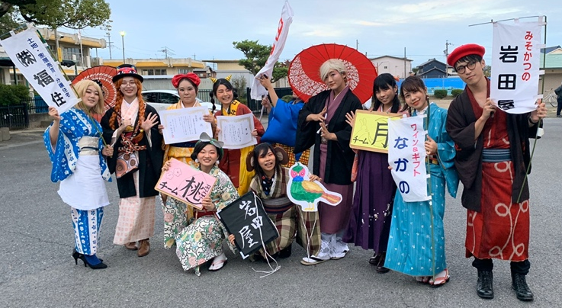
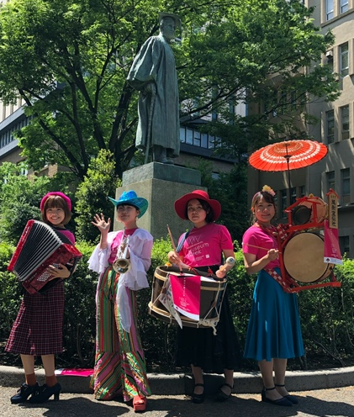
Activity
Performance video：https://www.youtube.com/watch?v=O8gMHbaxxWU
(←) Student chindon-ya performers gathering at a contest where we compete our advertising skill on stage.
(→) Advertising an event on campus. We also participate in events and festivals over east Japan.

Slide 4
Information
Type of Official Recognized Club：Circle
Year of Founding: 2000
Genre: Japanese culture
Activity Date: Every Wednesday and Friday (subject to change)
Member Composition：Total ７（１male, ６ladies. 1freshman, 3juniors, 3seniors. 0 international student）
Location：Toyama campus, student center, B1 rehearsal studio
Website：https://kazemachingdong.amebaownd.com/

Slide 5
Contacts
Gmail： chingdong.kazemachi@gmail.com
Twitter： @kazemachi_wsd
We hope to hear from you soon :D

