Slide 1
Waseda University
School of Advanced Science and Engineering
Toru ASAHI, Dean

Slide 2
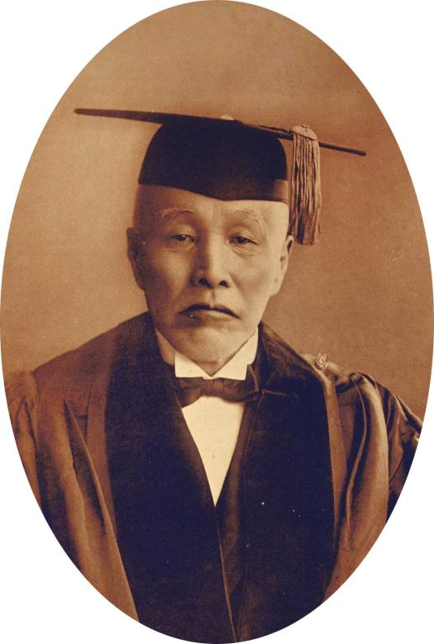
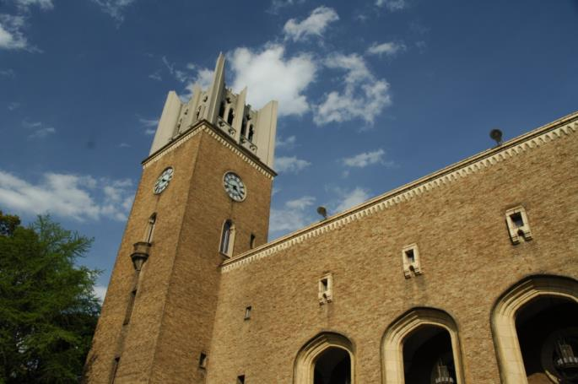
WASEDA
Waseda University
was founded in 1882
Okuma Shigenobu
WASEDA
Notes:
2

Slide 3
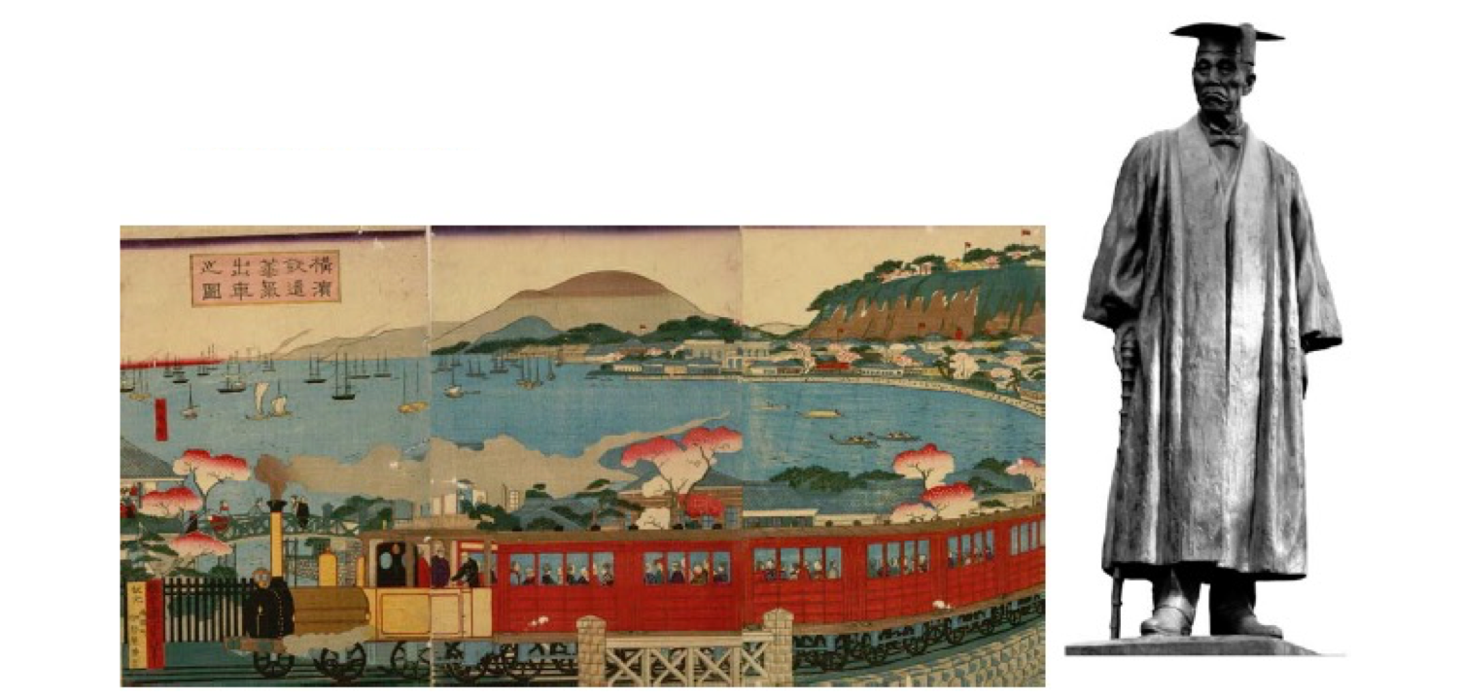
Okuma Shigenobu (1838-1922)
After the Meiji Restoration (1867), Okuma joined the new Japanese government. Harry Parks, the British minister, proposed the necessity of constructing railways, and Okuma was the only one in the government who agreed with him.
Three years later, the railroad between Tokyo (Shimbashi) and Yokohama opened. At that time, he stated, “I consider science and physics to be the foundations of all academic subjects” (at the 15th anniversary celebration of Waseda University).

Slide 4
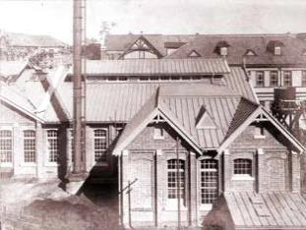
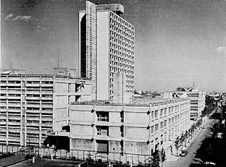
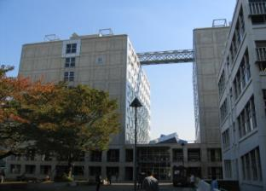
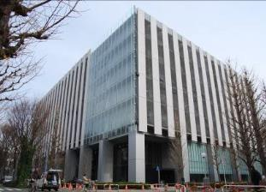

History of Science and Engineering Research
1882 Tokyo Vocational School founded
Renamed to Waseda University
The Department of Science and Engineering was established and the departments of Mechanical Engineering and Electrical Engineering were established.
The University was reorganized as a new university under the new university ordinance, and the Department of Science and Engineering was renamed the Faculty of Science and Engineering. Graduate School of Science and Engineering was established.
The new Waseda University is founded under the new system. The First and Second Schools of Science and Engineering were established.
Doctoral program established in the graduate school.
Moved to the new Okubo Campus (Nishi-Waseda Campus)
Abolished the Second Faculty of Science and Engineering. First School of Science and Engineering was renamed the School of Science and Engineering.
Environmental Safety Center established.
Changed the name of the Casting Research Laboratory to Kagami Memorial Research Institute for Materials Science and Technology.
Research Institute of Science and Engineering is renamed the Research Center for Science and Engineering.
Center for English Education in Science and Engineering was established.
Reorganized into 3 schools of science and engineering.
100th anniversary of the founding of the School of Science and Engineering. Center for Advanced Biomedical Sciences was established.
Okubo Campus is renamed Nishi-Waseda Campus
Five majors are established, including Japan's first three joint graduate schools.
2011 Department Intermedia Art and Science is established in the Graduate School of
Fundamental Science and Engineering

Slide 5
Departments
Fundamental
Creative
Advanced
School of
Fundamental Science and Engineering
School of
Creative Science and Engineering
Graduate School of
Advanced Science and Engineering
Department of Mathematics
Department of Applied Mathematics
Department of Applied Mechanics and
Aerospace Engineering
Department of Electronic and Physical Systems
Department of
Computer Science and Engineering
Department of Communications
Computer Engineering
Department of Intermedia Art and Science
Department of Architecture
Department of
Modern Mechanical Engineering
Department of Industrial and
Management Systems Engineering
Department of Civil and
Environmental Engineering
Department of Earth Science,
Resources and
Environmental Engineering
Department of Physics
Department of Applied Physics
Department of
Chemistry and Biochemistry
Department of Applied Chemistry
Department of Life science and
Medical Bioscience
Department of
Electrical Engineering and Bioscience
And graduate school.
Graduate School of
Fundamental Science and Engineering
Graduate School of
Creative Science and Engineering
Graduate School of
Advanced Science and Engineering
Graduate School of
Information, Production and Systems
Graduate School of
Environment and Energy Engineering
Department of
Pure and Applied Mathematics
Department of Applied Mechanics
Department of
Electronic and and Physical Systems
Department of Computer Science and
Engineering
Department of Intermedia Studies
Department of Architecture
Department of
Modern Mechanical Engineering
Department of Industrial and
Management Systems Engineering
Department of Civil and
Environmental Engineering
Department of Earth Sciences,
Resources and
Environmental Engineering
Department of
Business Design and Management
Department of Pure and Applied Physics
Department of Chemistry and Biochemistry
Department of Applied Chemistry
Department of
Life Science and Medical Bioscience
Department of Electrical Engineering
and Bioscience
Department of Integrative Bioscience and
Biomedical Engineering
Department of Nano-Science and Engineering
Cooperative Major
in Advanced Biomedical Sciences
Cooperative Major in Advanced Health Science
Cooperative major in Nuclear Energy
Department of
Advanced Science and Engineering
Notes:
In the Faculty of Science and Engineering at Waseda University, the
There are three schools of science and engineering.
We are in the "School of Fundamental Science and Technology," "School of Creative Science and Technology," and "School of Advanced Science and Technology," but we are in the "School of Advanced Science and Technology," the third blue area. The graduate school is called the "Graduate School of Advanced Science and Engineering".

Slide 6
What is Advanced Science and Engineering?
Physics
Chemistry
Electricity
and
Electronics
Life Science
Computer
Science

Slide 7
What is Advanced Science and Engineering?
Department of Physics
Physics
Department of Applied Physics
Department of
Applied Chemistry
Chemistry
Electricity
and
Electronics
Department of
Chemistry and Biochemistry
Department of Electrical
Engineering and Bioscience
Life Science
Computer
Science
Department of
Life Science and
Medical Biosciences
Notes:
The School of Advanced Science and Engineering is
It consists of six departments related to the fields and areas of "Physics", "Chemistry", "Electrical and Electronic Engineering", "Information" and "Life Sciences".
The departments of "Department of Physics", "Department of Applied Physics", "Department of Chemistry and Biochemistry", "Department of Applied Chemistry", "Department of Biomedical Sciences", and "Department of Electrical and Computer Science and Biotechnology".

Slide 8
Six departments of Advanced Science and Engineering
Basic education for all three schools of
science and engineering
Department of Physics
Classes for basic science and lab courses.
Language training
Liberal Arts Education
Department of
Applied Physics
Department of Chemistry and Biochemistry
Department of
Applied Chemistry
Specialized education based on
natural science
Department of Life Science and Medical Biosciences
Unique science and engineering education in each department
Department of Electrical Engineering and Bioscience
Developping basic academic skills
in undergraduate course
Notes:
In the School of Advanced Science and Technology, you will be asked to apply for a specific department from the time of admission.
Upon admission, you will be required to take "Basic subjects", "Experimental subjects", "Language classes", and "Liberal Arts" common to all three faculties of science and engineering.
From the first year, students are required to take specialized courses in each department, making the most of the characteristics of each department.
We also aim to develop a solid foundation of academic skills that will enable students to play an active role in their respective academic fields.

Slide 9
Stepping up from the basics to expertise through an integrated curriculum
first year
second year
third year
fourth year
Multidisciplinary Courses
Comprehensive Courses: Courses that allow students to comprehend
interdisciplinary issues in an integrated manner
Special Topics: approaching to humanities, social sciences
And technology issues from multiple perspectives
group A
22-28 credits
Foreign Language Courses
English
German, French, Chinese, Spanish and Russian
group B
22-32 credits
Mathematics
Natural science
Physics, Chemistry and Life Sciences
Basic Science and Engineering experiments, Computer Science and Related Courses
Specialized education courses - each department has its own unique characteristics
Introductory and Basic Courses, Specialized Basic Courses, Specialized Applied Courses Graduation Research
group C
62-82 credits
Graduation research
Pre-requisite for graduate courses
group D
Physical Education, and Other subjects (Engineering and Culture, Volunteering, Internship)
Cooperative-programs
Basic Exercises
Exercises and Graduation Thesis

Slide 10
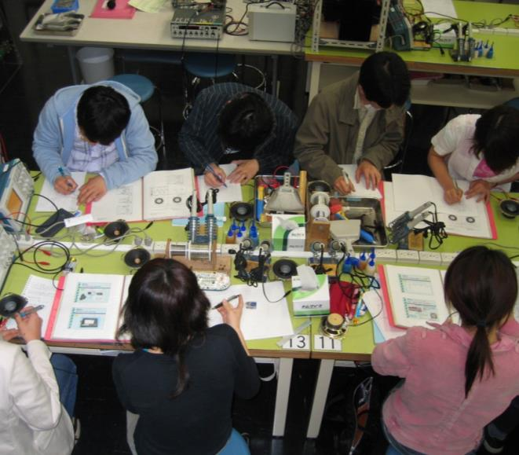
Experience-based program that fosters the ability to explore new things and carry on traditions
Faculty of Science and Engineering put emphasis on
"experience-based education" that allows students
to actually touch things and experience phenomena
Through lab courses and hands-on classes, students can better understand the content of classroom lectures and acquire the basics of techniques needed in the future. Students also experience the actual process of creating things and develop the ability to tackle problems on their own initiative.
Notes:
The School of Science and Technology at Waseda University has been a part of the School of Science and Technology since its inception.
Traditionally, we have emphasized "experimental education".
This science and engineering campus has excellent facilities and equipment for experimental education.
Staff specializing in experimental education is also available.
The experimental items in the basic experimental subjects are also
"Physics of the Electric Guitar,
"Design a condenser and listen to the radio,
"The Physics of Air Hockey,
The content is unique and distinctive, and there are even visits from other universities.
The event was held at Waseda University's Science and Engineering Campus in 2010.
The Chemistry Laboratory, which was renovated for the International Chemistry Olympiad, is our pride and joy.
We hope that you will enjoy your experiments in such a rich environment.

Slide 11
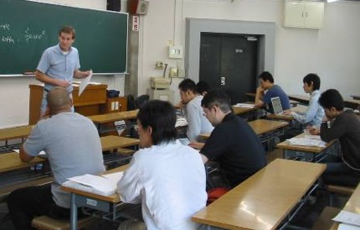
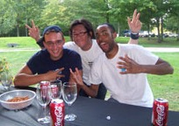
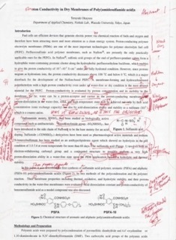

Effective English Education
Learn the skills
to read scientific papers in English.
to present and discuss scientific research in English.
Workplace English 1/2
Advanced Technical
Presentation
Special Topics in
Functional English
Advanced Technical
Reading and Writing 1/2
skill
Concept Building and
Discussion 1/2
Technical Writing 1/2
Technical Presentation
Communication
Strategies 1/2
Academic Reading 1/2
Academic Lecture
Comprehension 1/2
Practical training of English from undergraduate to graduate school.
Undergraduate Master‘s Degree Doctoral Degree
Notes:
English education is one of the characteristics of Waseda University's Faculty of Science and Engineering.
A faculty member of the Faculty of Science and Engineering in the Faculty of Science and Engineering, who is in charge of teaching English to students
We have developed a curriculum that fosters the English language skills required in science and engineering, and
A rich set of subjects unique to science and engineering is provided.

Slide 12
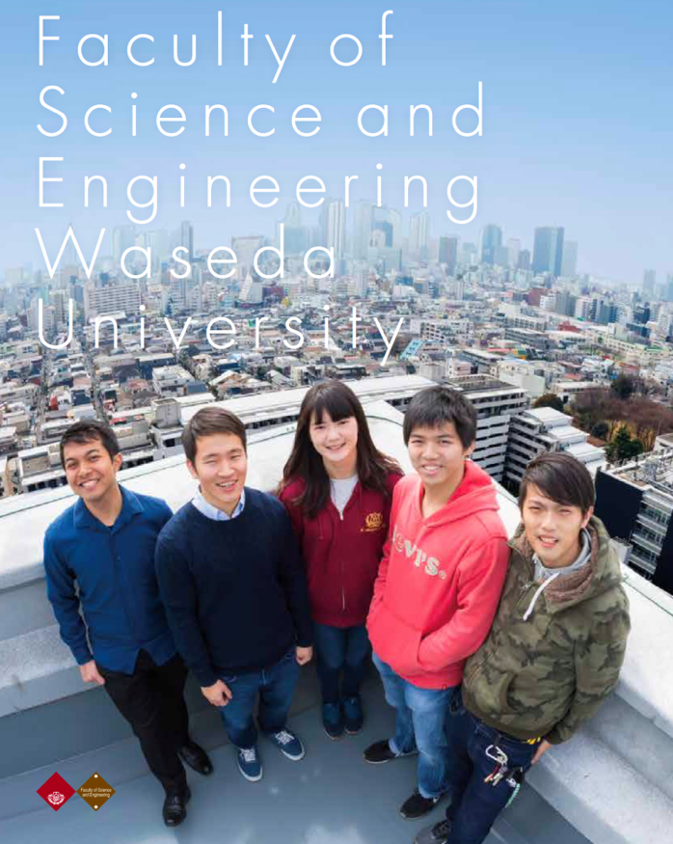
English-based Programs
https://www.waseda.jp/fsci/en/about/education/english-based/
Notes:
The Faculty of Science and Engineering of Waseda University has been working on
The International Course, which enables students to earn an undergraduate degree in English, was introduced.
We have accepted students from abroad.
In the 2018 academic year, this was renewed and evolved into an "English Degree Program".
The School of Advanced Science and Engineering has three majors: Physics, Chemistry, and Bioscience.
Japanese and foreign students study their respective fields of expertise in small groups.
When I walk around the campus of science and engineering, I hear many different languages of countries.
For students in the regular Japanese language course
You will have opportunities to interact with foreign students from abroad.
We hope that you will be able to enjoy your student life in a global environment.

Slide 13

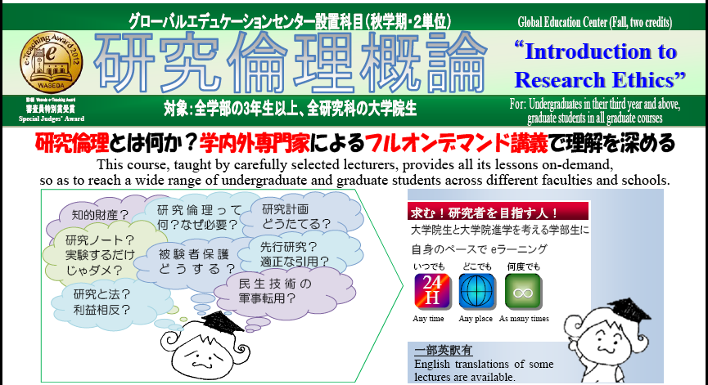
Research Ethics
Programs given by each department
University-wide on-demand content "Introduction to Research Ethics "
Notes:
As a matter of course.
We also focus on education in research ethics.
In addition to the lecture courses available throughout the university, there are
Each department has its own initiatives.

Slide 14
Research at the (Graduate) School of Advanced Science and Engineering
Research application to
Industries and Real-life
The Quest for Truth
Physics
Chemistry
Basic research
Electoricity
and Electronics
Life Science
Computer Science
Notes:
In the area of research, based on "physics", "chemistry", "electrical and electronic engineering", "information technology", and "life sciences", the following fields of study have been developed
Rooted in "basic and fundamental research" that supports each discipline and field of study
From "the search for the truth of nature" to "research leading to practical use, industrialization and application,
We have a wide range of research projects.
In addition to the basic sciences, such as "elementary particles and the universe,
With the keywords "matter," "life," and "system,
Nanomaterials," "Devices," "Energy," "Bioscience," etc.
We are conducting research in the "Cutting-edge Research Area".

Slide 15
From undergraduate school to graduate school
6 departments
11departments
School of
Advanced Science and Engineering
Graduate School of
Advanced Science and Engineering
Department of Physics
Department of Applied Physics
Department of
Chemistry and Biochemistry
Department of Applied Chemistry
Department of Life science and
Medical Bioscience
Department of Electrical
Engineering & Biosciences
Department of Integrative Bioscience and
Biomedical Engineering
Department of Nano-Science and Engineering
Cooperative Major in Advanced Biomedical
Sciences
Cooperative Major in Advanced Health Science
Cooperative Major in Nuclear Energy
Department of Advanced Science and Engineering
(5 Years)
Higher education
Department of Pure and Applied Physics
Department of Chemistry and Biochemistry
Department of Applied Chemistry
Department of Life Science and Medical
Bioscience
Department of Electrical Engineering and
Biosciences
Recommendation system
Notes:
Students will be working on their graduation research in their fourth year, and by the time they become a graduate student
You will be working in the most advanced area of research.
The Graduate School of Advanced Science and Engineering has 11 departments.
It was established on top of the six departments of advanced science and engineering.
Department of Physics and Applied Physics", "Department of Chemistry and Biochemistry", "Department of Applied Chemistry", and "Department of Physics and Applied Physics".

Slide 16
11 majors in the Graduate School of Advanced Science and Engineering
Education and Support for All Three Schools
of Science and Engineering
Department of Pure and Applied Physics
Integrated English education program from undergraduate to graduate levels
Career Support through Industry-Academic Collaboration
Department of Chemistry and Biochemistry
Department of Applied Chemistry
Department of
Life Science and Medical Bioscience
Academic Research beyond
Traditional Research Fields
Department of
Electrical Engineering and Bioscience
Expansion into new and interdisciplinary fields
Interdisciplinary majors and Cooperative majors
Interdisciplinary
majors
Department of Integrative Bioscience and
Biomedical Engineering
Department of Nano-Science and Engineering
Cooperative
majors
Cooperative Major in
Advanced Biomedical Sciences
Developing professional skills to solve problems in a wide range of fields
Cooperative Major in
Advanced Health Science
Cooperative Major in Nuclear Energy
Five-year program
Department of
Advanced Science and Engineering
Notes:
As an interdisciplinary major that transcends the boundaries of academic departments and faculties, the Department of Interdisciplinary Studies
The Department of Bioscience and Biotechnology and the Department of Nano-Science and Engineering have been established.
In addition, we have been working together with other universities as a "joint department" to conduct research and education beyond the boundaries of the university.
The Joint Department of Advanced Biomedical Sciences, the Joint Department of Advanced Health Sciences, and the Joint Department of Nuclear Energy have been established.
In addition, we provide integrated education during the five years of the master's and doctoral programs to foster leaders who are active in the world of research and in society.
We have a 5-year program in Advanced Science and Engineering.

Slide 17
Undergraduate/graduate school education to develop a high level of expertise
Through a unique education and research program that integrates science, which aims to pursue principles, and engineering, which leads to technologies contributing to society, we educate students with a high degree of expertise and the ability to understand problems from a broad perspective.
Students can take lecture courses at the graduate school while they are in the undergraduate program so that they can learn efficiently from undergraduate to graduate school.
Using the skipping grade system, students can obtain a doctoral degree within six years of entering the undergraduate course.
1
2
3
4
5
6
7
8
9
Students with various abilities, personalities, and motivation
Undergraduate
Graduate school
master's course
Graduate school
Doctor degree
Basic Academic Skills
Problem-Solving
Professional Skills
Professional persons with a broad perspective and deep insight
Highly specialized
leading persons
in the international community.
Top leveled
Creative Researchers

Slide 18
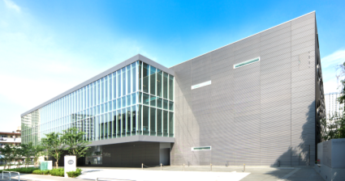
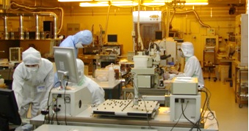
Leading Waseda as a research university
  Strengthen important fields through
  Cooperative Majors and collaborations
medicine
    Tokyo Women's
    Medical University
health
    Tokyo University
    of Agriculture and
    Technology
nuclear
power
    Tokyo City
    University
The Center for Advanced Biomedical Sciences (TWIns)
External Collaborators
RIKEN
Tsukuba National Institute of Advanced Industrial Science and Technology
Tsukuba, National Institute for Materials Science (NIMS)
Japan Aerospace Exploration Agency (JAXA)
National Center for Neurology and Psychiatry
Japan Atomic Energy Agency (JAEA)
Nanotechnology Research Facility
University Research Center
Nano-Life Research Institute
WISE, GCOE, ans 21COE programs
High-tech research centers
Notes:
In addition to collaborating with other universities through the Joint Major, we are also working on the following
We are developing cutting-edge research in collaboration with various research institutions outside the university.

Slide 19
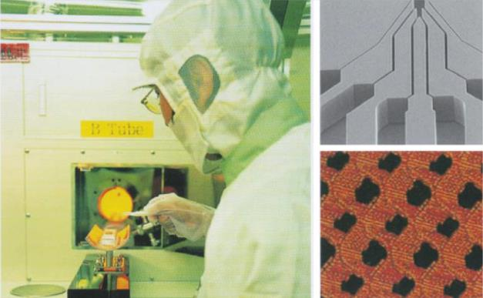
Obtaining a research budget to conduct world-class research
Support for Pioneering Research Initiated by the Next Generation Program（SPRING）
Moonshot Research and Development Program
Exploratory Research for Advanced Technology Program (ERATO)
Program for Creating STart-ups from Advanced Research and Technology （START，SCORE，STARTUP ECOSYSTEM）
Basis for Supporting Innovative Drug Discovery and Life Science Research (BINDS)
Doctoral Program for World-leading Innovative & Smart Education (WISE Program)
Exploration and Development of Global Entrepreneurship for Next Generation Program (EDGE-NEXT)
Enhancing Development of Global Entrepreneur Program (EDGE)
Program for Leading Graduate Schools
Global COE Program
Strategic Research Center Development Program (Super COE)
Global 30 Program
21st Century COE Program
Private University Strategic Infrastructure Formation Support Project
Grant-in-Aid for Scientific Research etc.
Notes:
In addition, the Graduate School of Advanced Science and Engineering has received many research funds and
We are conducting world-class research.

Slide 20
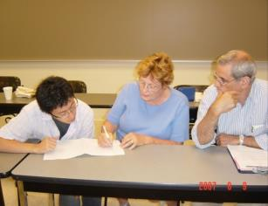
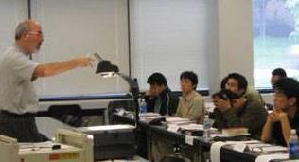
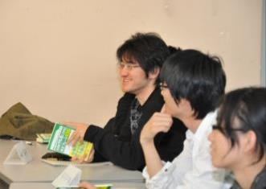
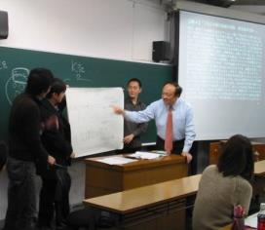
Various Scholarship Programs
More than 80% of undergraduates go to master's programs
Scholarships: loans and grants
Japan Student Services Organization (JASSO):Loan
Variety of scholarships from the Japan Student Services Organization (JASSO) and private organizations to support undergraduate and graduate students financially
Most of the graduate students (more than 1,000) can obtain a scholarship if they apply
On evaluation of activities during the master course
(papers, conference presentations, awards, TA’s experience, etc.)
Many master's students go on to doctoral programs
People with PhDs are working in various companies
Students can obtain a “Scholarship for Fostering Researchers in Doctoral Programs”
Full or half repayment
may be exempted
Notes:
There are various scholarship programs available at Waseda University.
In particular, the Graduate School of Advanced Science and Engineering is committed to supporting master's students.
We have our own scholarship program for advanced science and technology.
Graduate students who present their research results at an international conference will be rewarded with the following
The Graduate School of Advanced Science and Engineering subsidizes a part of the conference participation fee.

Slide 21
Career paths for March 2024 Graduates
Employed
Master’s program
Preparation for qualiication exams
others
Master’s program
Master’s program at Waseda
Master’s program at other universities
Doctor program

Slide 22
Main Employment Opportunities for Graduates
(Results for March 2019 graduates)
Major employers
Accenture
Asahi Kasei
Ajinomoto
AGC
NTT DATA
Olympus
Kao
Canon
Kyocera
Kirin Beverages
JXTG Energy
Shin-Etsu Chemical Co.
Sumitomo Chemical
All Nippon Airways (ANA)
Sony
SoftBank
Daiichi Sankyo
Dai Nippon Printing Co.
Takeda Pharmaceutical Co.,Ltd.
Terumo.
Power supply development
Denso
Dentsu
Tokyo Gas
Tokyo Electric Power Company Holdings, Inc.
Mitsubishi Electric Industrial Systems,
Toshiba Corp.
Toray Industries, Inc.
Toyota Motor Corporation
IBM Japan, Ltd.
Oracle Corporation of Japan
Nippon Steel Corporation
Japan Tobacco Inc.
Japan Broadcasting Corporation (NHK)
Nomura Research Institute, Ltd.
Panasonic
Nippon Telegraph and Telephone Corporation (NTT East)
East Japan Railway Company
(JR East)
Hitachi, Ltd.
Fujitsu
Fujifilm
Honda Motor Co.
Mitsui Chemicals, Inc.
Mitsui & Co.
Mitsubishi Chemical
Mitsubishi Heavy Industries, Ltd.
Mitsubishi Electric
Mitsubishi Materials Corporation
Mitsubishi UFJ Bank
Murata Manufacturing Co.
Morinaga Milk Industry Co.
Yokogawa Electric Corporation
The Lion
and many more
Notes:
He's doing very well in the job market.
Many of our graduates are active in society.

Slide 23
Introduction to Department of Physics

Slide 24
Research Field (Department of Physics)
Composition of the Department of Physics
Nuclear and
Elementary
Particle
Physics
Astrophysics
Getting to the Ultimate World
Quantum and
Condensed Matter
Physics
Biophysics
Pursuing New Materials and
New Phenomena
Unraveling Complex
Life Phenomena

Slide 25
Research content (Physics)
Elementary Particle and Astrophysics
  Research on physical laws of the microscopic world such as quarks and neutrinos (quantum theory and particle theory)
  Theoretical and experimental research on the origin and evolution of the universe, black holes, supernovae and other unknown objects based on modern physics (relativity and quantum theory)
Quantum, Condensed Matter Physics, Nonlinear Science, Statistical Physics
  Study of various properties of solid materials such as superconductivity, superfluidity, Bose-Einstein condensation, magnetism, and dielectricity
  Extraction of universal kinetic structure independent of system details, such as physical systems (mechanical properties and crystal growth of soft matter), chemical systems and biological systems
Biophysics
  Research on the function and structure of proteins (biomolecular machines) that play a role in biological locomotion and energy conversion from both experimental and theoretical perspectives
  Studying the mechanisms (principles) that govern life from the perspective of physics

Slide 26
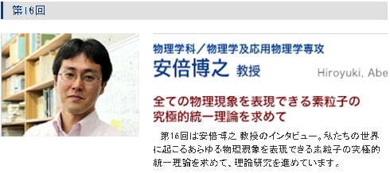
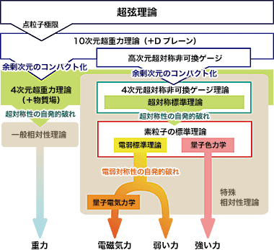
Physics Department Faculty
Advanced Top Runner
The smallest components of matter are called subatomic particles, which are classified according to their properties into leptons, such as electrons, quarks, which make up protons and neutrons, and gauge particles, which mediate the forces acting between these particles of matter. It is believed that our world exists and all phenomena are caused by the interaction of these elementary particles, but no theory has been developed to explain them all since the beginning of history. Associate Professor Hiroyuki Abe of the Department of Physics is challenging this difficult question from a phenomenological perspective.

Slide 27
Introduction to
Department of
Applied Physics

Slide 28
Research Field (Applied Physics)
Innovate physics and next-generation technologies by leveraging the fruits of physics and research methodologies
Physics-based Engineering:
Informatics, Photonics, Image Science
Applied Radiation Physics
Condensed Matter Physics
Mathematical Physics
Theory of Condensd Matter Physics

Slide 29
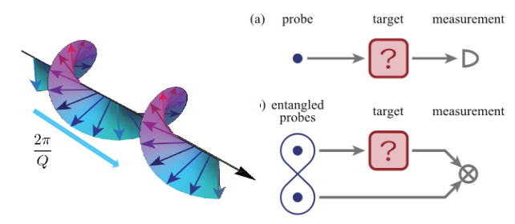
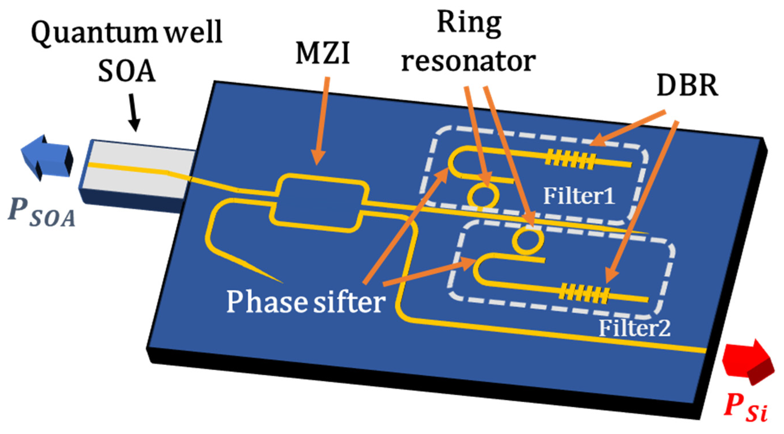
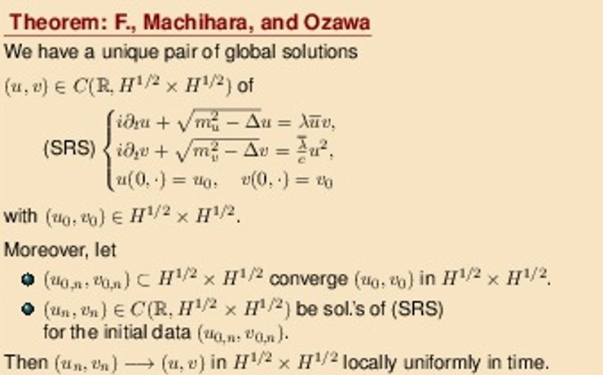
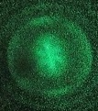
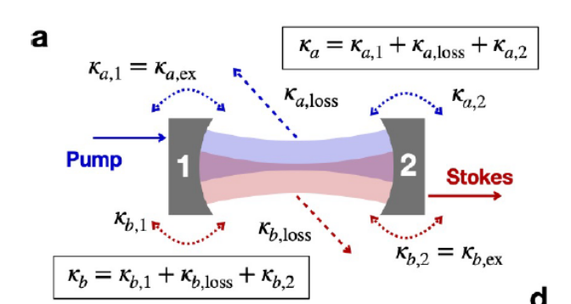
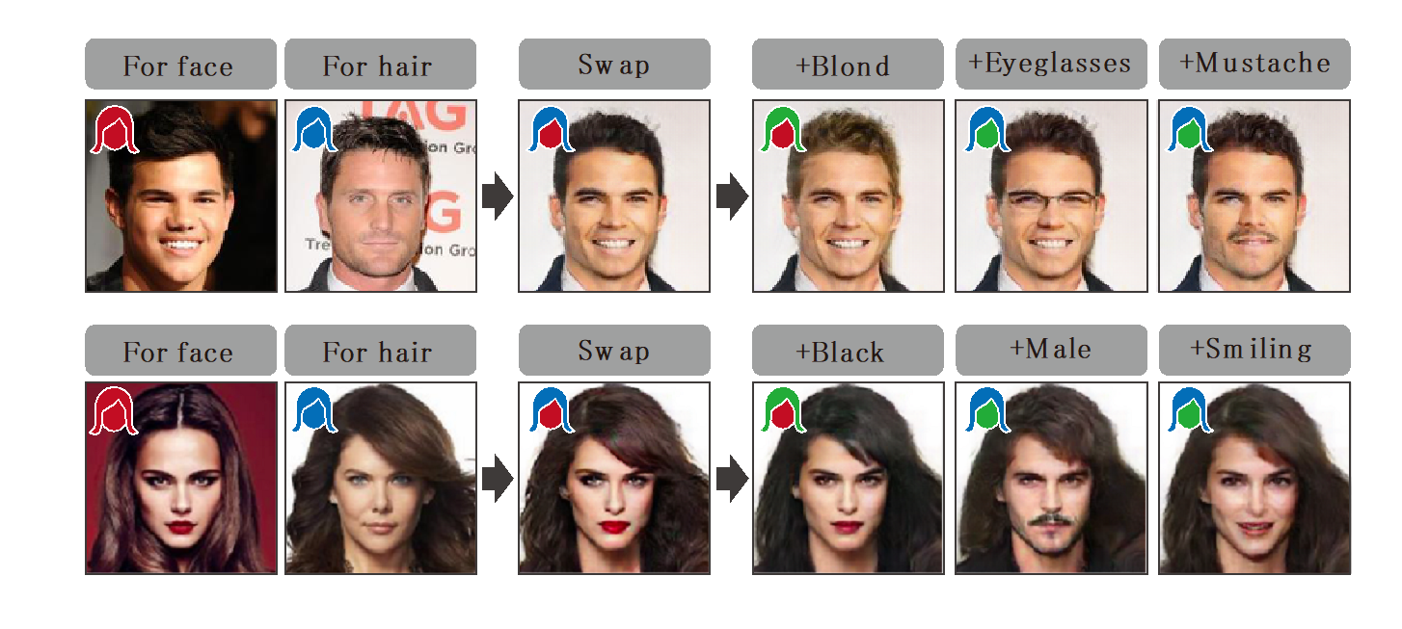
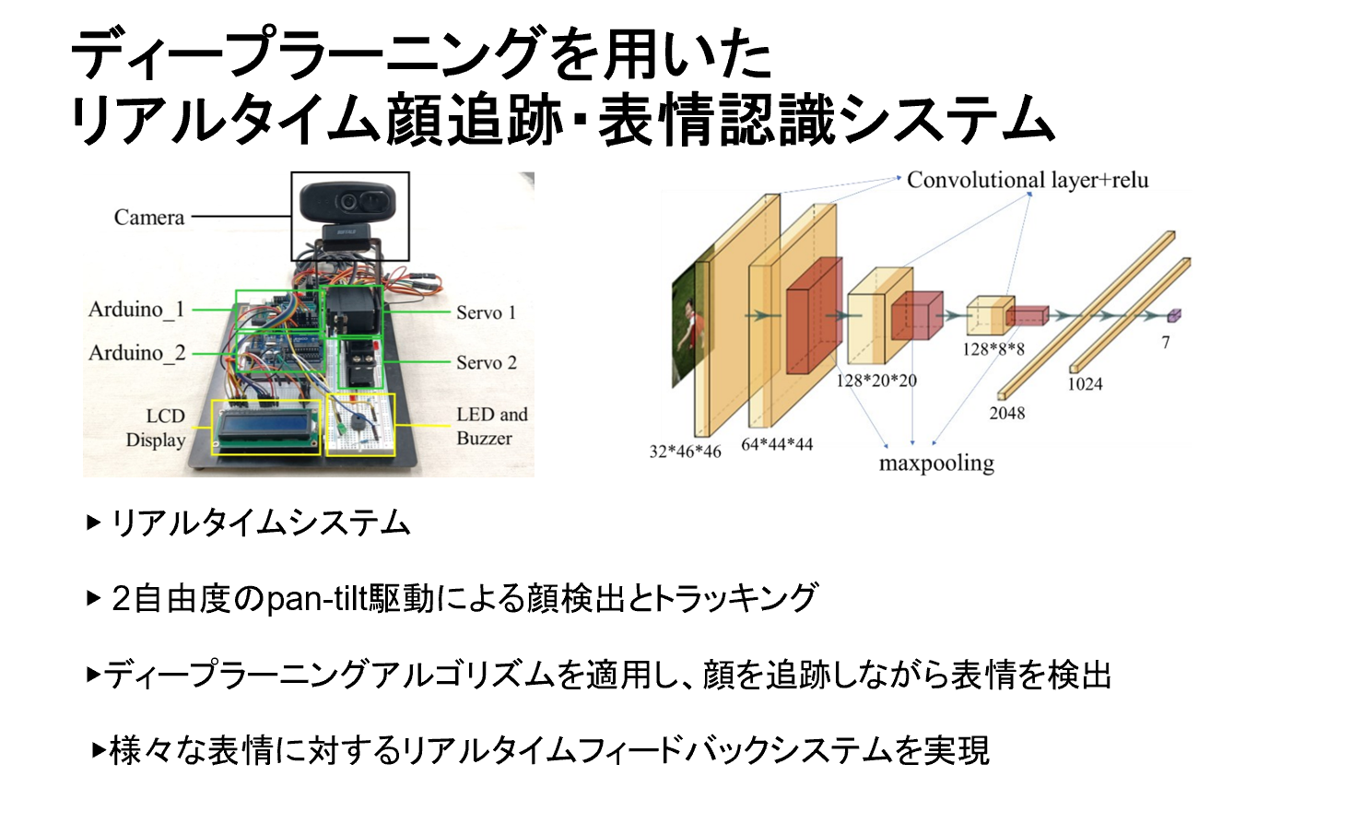
Examples of Research Topics (Applied Physics)
Theory for physical behavior of electrons, spins, magnets etc.
Two-Wavelength Tunable Laser
Describe and predict new physical phenomena with mathematics
Brillouin lasing in short fiber Fabry–Perot resonators
Imaging of wave function by Attosecond laser
Deep Learning-Based System for Real-Time Face Tracking and Expression Recognition
Anatomy Based Facial Animation and Fat Simulation

Slide 30
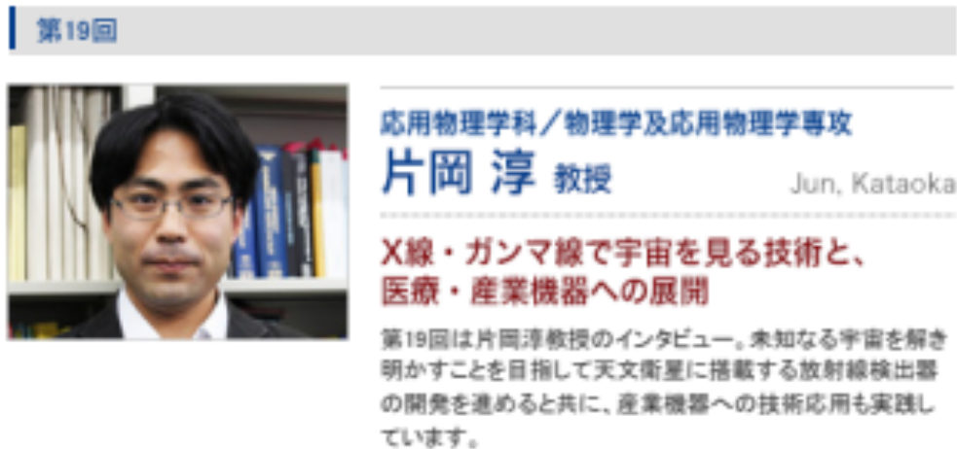
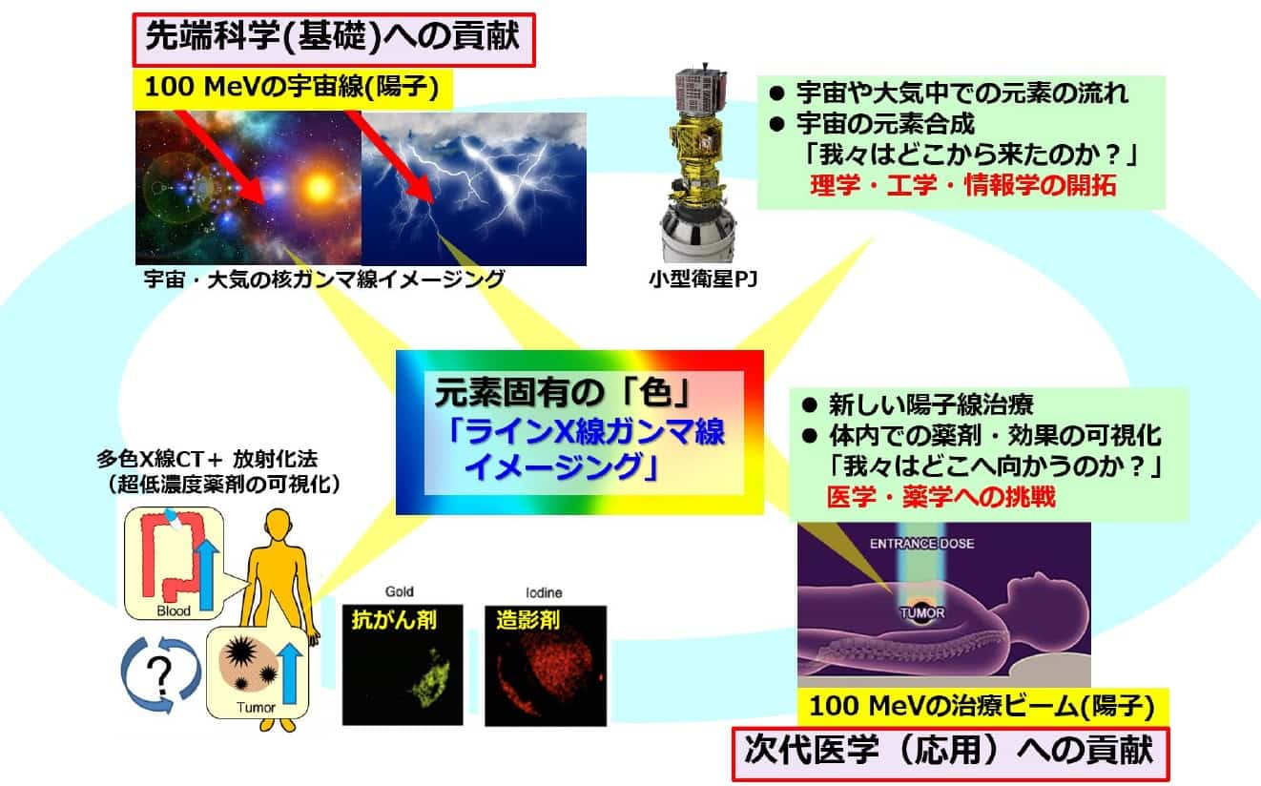
Faculty in the Department of Applied Physics
Advanced Top Runner
Exploratory Research for Advanced Technology Program (ERATO)
Kataoka Project
Ordinary astronomical telescopes use visible light to observe the moon and stars, but in order to observe special astronomical objects such as giant black holes and neutron stars at greater distances, high-temperature gases that are invisible to the human eye but exist in space, and explosive phenomena, electromagnetic waves such as X-rays and gamma rays, which have a higher energy than visible light, are used to observe the moon and stars. (a type of radiation) is advantageous. In the field of high-energy astrophysics, Professor Jun Kataoka of the Department of Applied Physics is developing radiation detectors and optical sensors to observe unknown celestial objects and reveal their true nature.
https://www.jst.go.jp/erato/research_area/ongoing/jpmjer2102.html

Slide 31
Introduction to
Department of LiFE SCIENCE and MEDICAL BioSCIENCE

Slide 32
Research Field (Department of Chemistry and Biochemistry)
Related Areas and Curriculum
drug discovery science
biotechnology
chemical synthesis method
biomolecular chemistry
advanced system
medical and biological
engineering
reaction organic chemistry
organic chemistry
biochemistry
structural organic chemistry
molecular biology
inorganic reaction chemistry
functional organic chemistry
chemical biology
inorganic chemistry
analytical chemistry
complex chemistry
theoretical chemistry
instrumental analysis
chemistry
nanotechnology
electronic state theory
environmental science
physical chemistry
spectroscopy
computational chemistry
photophysical chemistry
structural chemistry
information science
Learn a wide range of "chemistry"

Slide 33
Educational Content and Objectives (Chemistry and Biochemistry)
Fundamental Law of Matter and Energy
The starting point for cutting-edge science and technology
Science of molecules to create new materials
Elucidation of chemical and biological phenomena at the molecular level
"Central Science"
Basis for collaboration with engineering, life sciences, pharmaceutical and natural sciences
Aiming to foster creative excellence

Slide 34
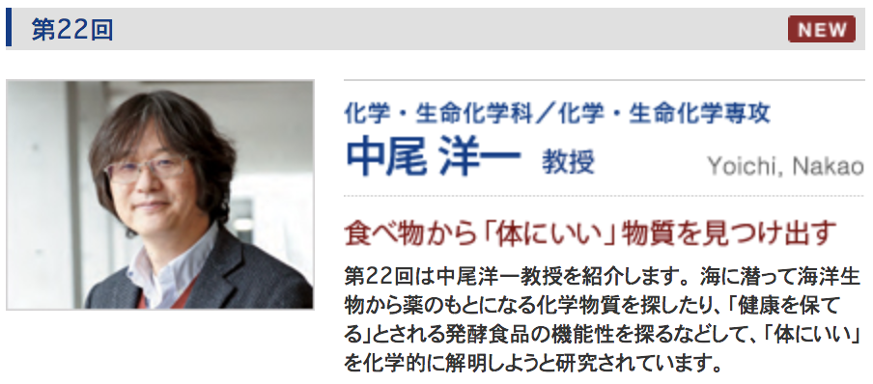
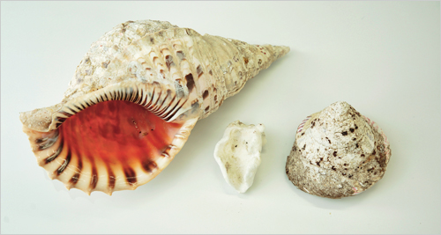
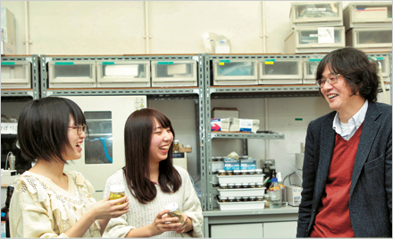
Faculty in the Department of Chemistry and Biochemistry
Advanced Top Runner
A variety of marine life
It is often said that traditional fermented foods are good for you, such as "drinking miso soup every day will keep you healthy" and "Natto is good for you". In the world of food chemistry, which is based on nutrients, many explanations are based on the function of minerals, vitamins, etc. Recently, catechins and isoflavones are said to be good for you. However, are they really the only reasons why catechins and isoflavones are "good for you"? Isn't there more hidden in food that we don't know about? Based on this idea, we are searching for chemical substances in fermented foods that are considered to be "good for you" and "keep you healthy" that have some effects on living organisms (i.e., have biological activity).

Slide 35
Introduction to
Department of
Applied Chemistry

Slide 36


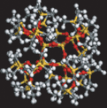

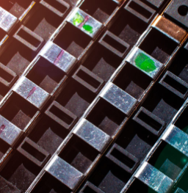
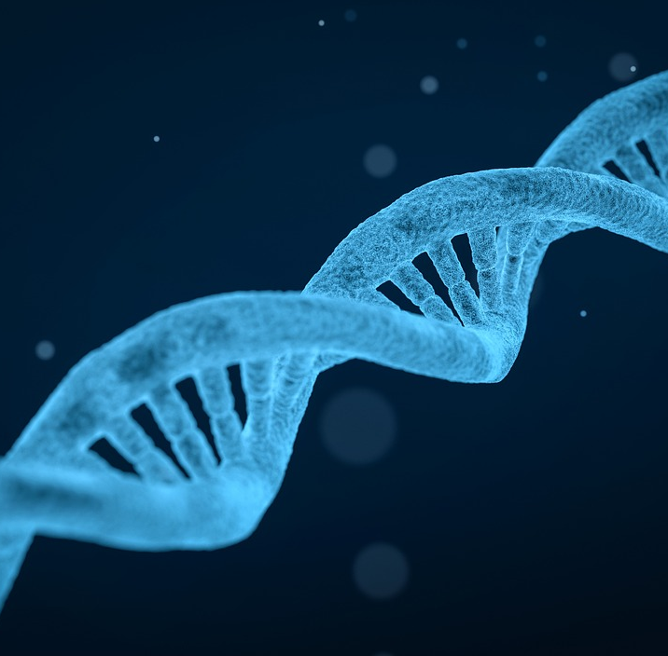

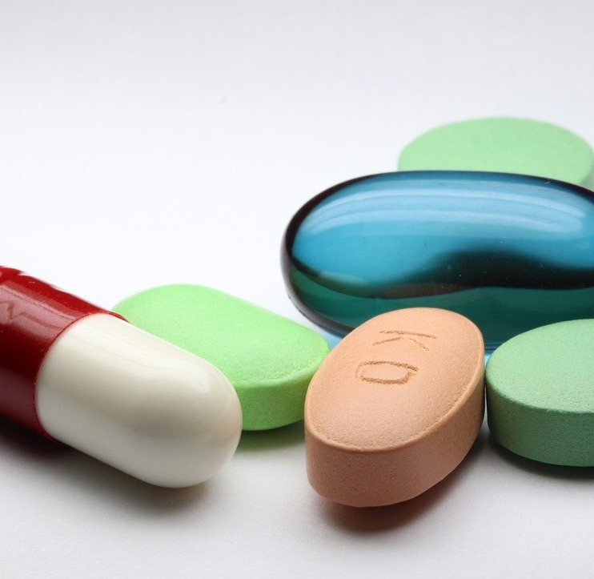

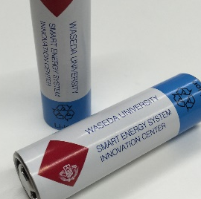
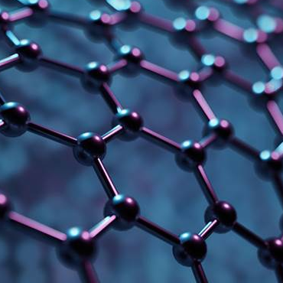
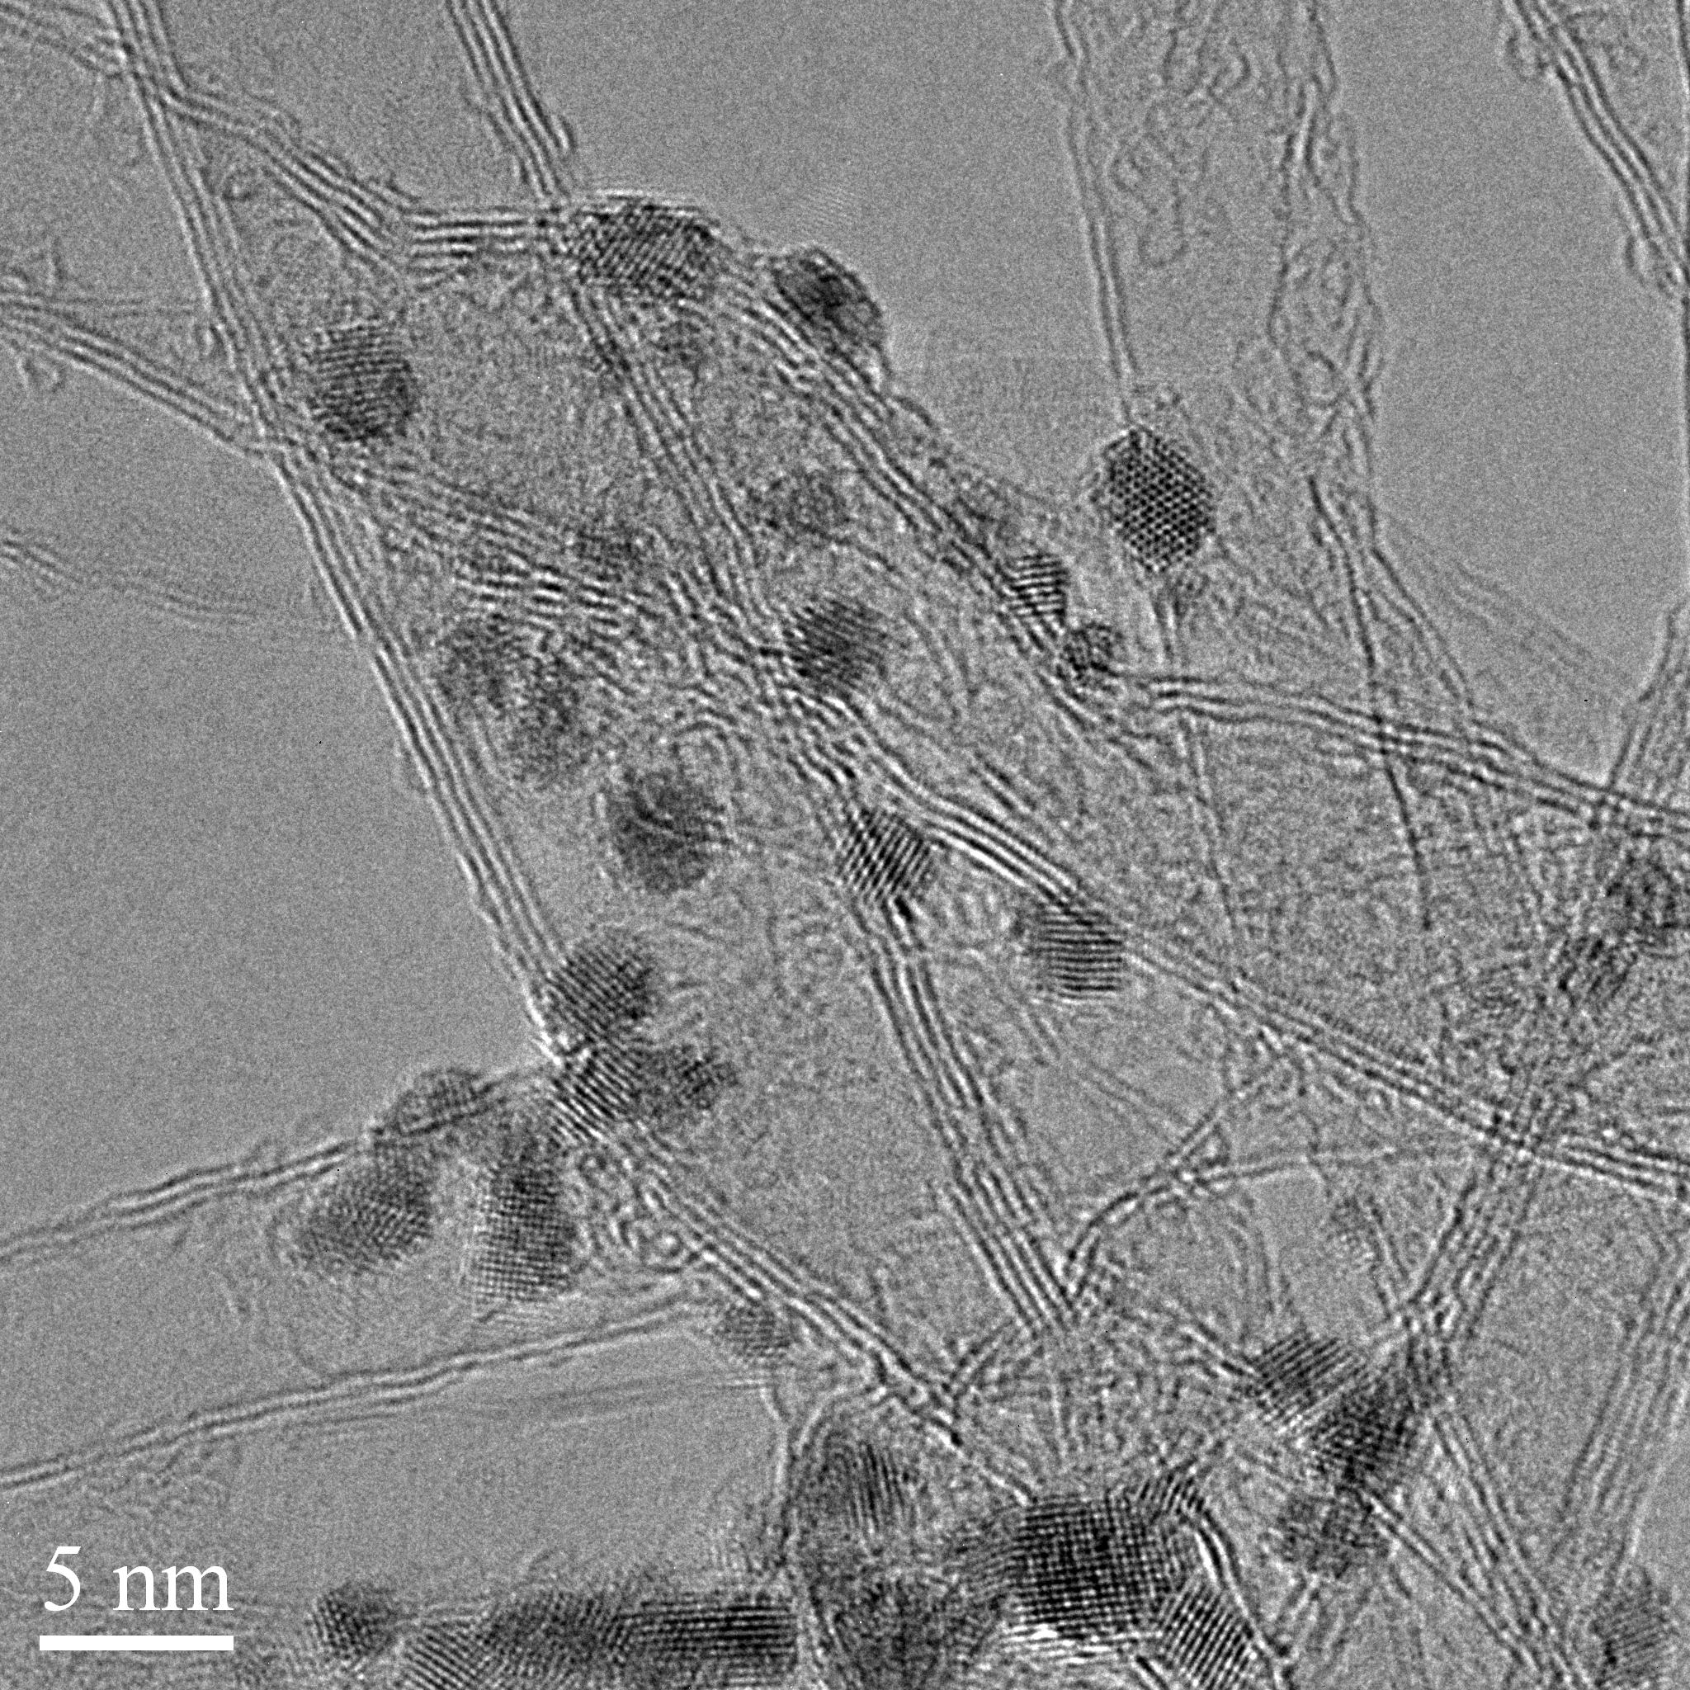
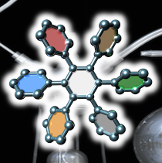
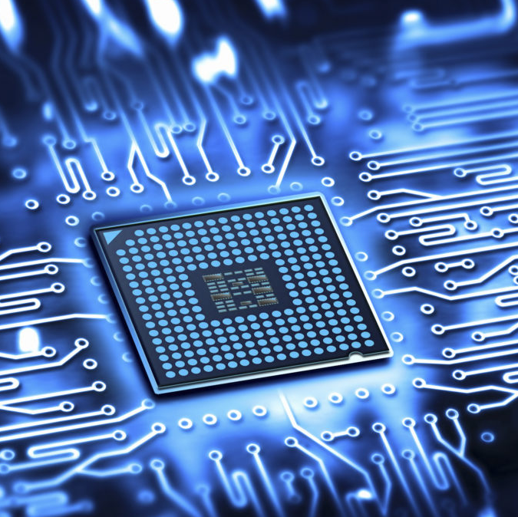
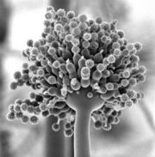
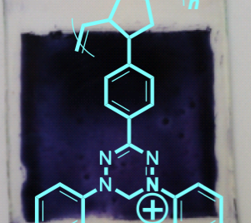


8 Research Field (Applied Chemistry)
Inorganic
Chemistry
Materials Design Engineering
Materials
Biotechnology
Catalytic Chemistry
Food
Cosmetics
Medicine
8
research
division
Applied Physical Chemistry
Applied
Chemistry
Contribution
to Society
Nanotechnology
Chemical Engineering
Synthetic Organic Chemistry
Electronics
Applied
Biochemistry
Polymer Chemistry
Environment
Energy

Slide 37
Educational Content and Objectives (Applied Chemistry)
Practical Applications of Theories
  Practical Chemistry as Solutions for Sustainable Society
  Integration of Interdisciplinary Fields Based on Chemistry
Education and Research
  “Lecture-Practice-Experiment” Cycled Programs to Master Practical Chemistry
  Cutting-edge Research in 8 Research Divisions Related to Energy, Materials, Biotechnology, and Carbon Neutrality
  Great Research Facilities Supported by National Grants and Industrial Collaborations
Our History and Tradition
  since 1917, Active and Strong Network of >10,000 alumni.
  Our own scholarship programs

Slide 38
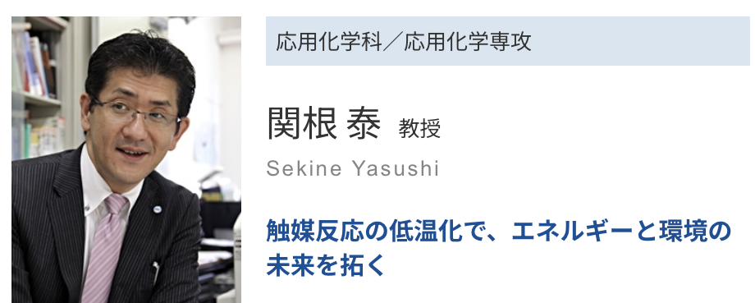
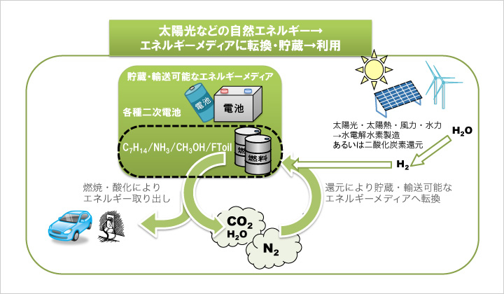
Faculty in the Department of Applied Chemistry
Advanced Top Runner
Exploration of Non-conventional Catalytic Process
for Transformation, Storage, and Utilization of Renewable Energy
Prof. Sekine has proposed an “Non-conventional” catalytic process that can operate at temperatures as low as 100°C in which an electric field is applied to the catalyst layer. He is challenging the development of catalytic processes to solve the time and space constraints of renewable energy, such as ammonia and biomass.

Slide 39
Introduction to
Department of Life and Medical Sciences

Slide 40
Research Field (Life Science and Medical Bioscience)
Science, engineering and basic medicine
Anatomy and Histology Laboratory, Physiology, Biochemistry, Pharmacology
Genetic medicine, immunology, and
Introduction to Clinical Medicine, etc.
Physical Chemistry, Analytical Chemistry, Organic Chemistry, Basic Statistics, and
Applied Mathematics, Bioinformatics Exercises, etc.
medical science
subject
science and technology
subject
Integration of
Science and Engineering and
Medicine
Molecular and Cellular Biology,.
Microbiology, Developmental Biology, and
Neuroscience,.
Introduction to Research Ethics, etc.
life science
subject
Bio-medicine I is to learn
faculty philosophy and research
Bio-medical Sciences II is for
Guidance for Laboratory Assignment
Notes:
Next, let's take a look at the department's curriculum.
As shown here, the curriculum of the Department of Biomedical Sciences is a unique blend of science and engineering and medicine.
In science and engineering subjects, students learn the basics of physics, chemistry and mathematics. In the life sciences, students are exposed to the study of genes, proteins, and cells to understand biological phenomena at the cellular level. At the same time as acquiring this knowledge, students listen to lectures on medical subjects, mainly by faculty members with medical school backgrounds, to learn what is happening in the field of medicine and medical care and what is required of them. By studying these subjects comprehensively, you will be able to understand, for example, how drugs work on cells to cure diseases, and how the same drug can have strong side effects depending on the type of gene. And you will be able to think about how to solve the problem of side effects.
40

Slide 41
Educational Content and Objectives
(Life Science and Medical Bioscience)
We train our students to be global leaders in
life sciences, medical sciences, and medical engineering
Students are required to complete a good balance of science and engineering, life science, and medical subjects and experiments to develop the academic ability to understand biological phenomena from cells to individuals.
This is a 6+3 year intensive education and research program that includes doctoral courses in collaboration with domestic and international educational and research institutions and corporate researchers.
Faculty members from various backgrounds are fused together in an open laboratory to develop international researchers with a pioneering spirit that creates new fields.
For more information, please visit the Department of Life Science and Medical Biosciences website.
(http://www.biomed.sci.waseda.ac.jp/).
Notes:
The Department of Biomedical Sciences has a different role than the department that trains doctors. Our goal is to develop human resources who will support the foundations of medicine and medical care by deepening academic knowledge and developing technology. The Department of Biomedical Sciences, with its well-developed research environment at TWIns, is a leader in research in the fields of life sciences, medical science and medical engineering in collaboration with a wide range of domestic and international research institutions.
Let's study in our department and become a leader in the century of life.
This concludes our introduction to the Department of Biomedical Sciences.
41

Slide 42
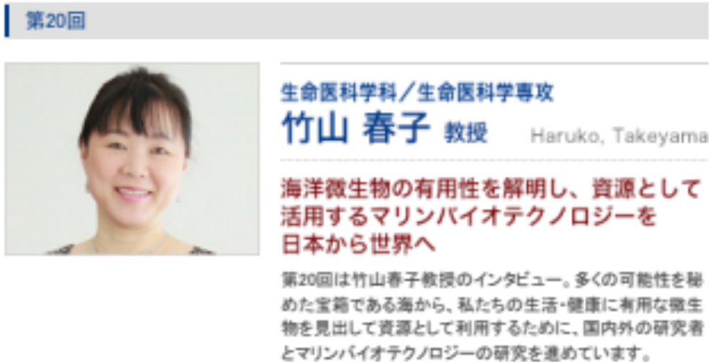

Faculty in the Department of Biomedical Sciences
Advanced Top Runner
The Moonshot Research and Development Program Goal 5
“Construction of circulating production platform by environmental control based on Soil Microbe Atlas”
Most of the microorganisms on Earth have not been successfully cultivated and, as a result, their properties and characteristics are not known. In particular, since many microorganisms in the ocean are even more difficult to culture than those on land, the ocean is expected to be a treasure chest with many hidden possibilities. Professor Haruko Takeyama of the Department of Life Science and Medical Biosciences is engaged in research and development of marine biotechnology for the microorganisms of the sea, using cutting-edge technologies such as genetic engineering, Raman spectroscopic analysis technology and microfluidic devices.
https://www.microbe-soil.sci.waseda.ac.jp/2021/06/08/84/

Slide 43
Introduction to Department of Electrical ENGINEERGIN and BioSCIENCE

Slide 44
Research Field (Electrical Engineering and Bioscience)
Human body is information bodies
connected with electrical signals
Combining life sciences and electrical and electronic information fields
life cycle
biological rhythm
Four vertices in the four domains of life, electricity, electronics and information
DNA functional structure
neuroscience
theoretical biology
Challenging both "research in depth in each field" and "research that spans multiple fields
intracellular signal transduction
machine learning
Various research fields
natural energy
synthetic biology
stochastic information
processing
bioinformatics
Themes that sharply penetrates each field
photobiological control
biometric identification
A theme that lies on the line connecting the two vertices
Electric energy system
information-
related
electrical
system
medical optics
A theme corresponding to a surface composed of three vertices
system design
computer-vision
superconductivity
Photonic Materials
A theme leading to a consolidated research composed of all four vertices
power electronics
optical integrated circuit
Functional Materials
quantum materials
Semiconductor Nanotechnology
The theory and technology gained at each field
expand into the fusion field.
electronics
Consolidate lots of research examples in the fusion field
and develop them into higher level ressearch

Slide 45
Education (Electrical Engineering and Bioscience)
Educational Programmes: Subject Group System
Advanced Subjects and Graduate School Courses
Specialized Subjects
Basic Life Sciences
The Molecular Biology of Medicine and Time
The Science of Health and Disease
life cycle
The Biology of Genetics and Diversification
Introduction to Medical Electronics
Introduction to Biophysics
Synthetic biology
Introduction to Medical Electrical Measurement
Life Information Science
Introduction to Energy Systems
Basic
Subjects
Simulation
information-related
Power network
Stochastic information processing
Introduction to Energy Conversion
electrical system
Introduction to Computational Science
Introduction to Materials Science
Introduction to Data Analysis
Introduction to Electronics
Control theory
electronics
Introduction to Computer Software
Introduction to Structure of Matter
Introduction to Computer Hardware
Quantum science
The Science of Vacuum

Slide 46
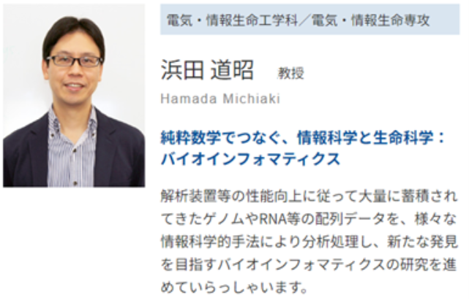
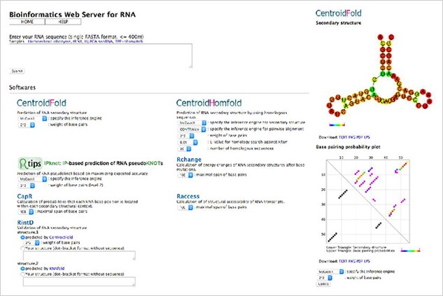
Faculty members of the Department of Electrical Engineering and Bioscience
Advanced Top Runner
Rtools, a web server that integrates a number of RNA information analysis tools
Since the discovery of DNA, the source of life, in 1869, many scientists have been studying it, and the Human Genome Project, completed in 2003, has revealed the entire DNA sequence of humans. At present, research is being conducted based on this information to elucidate the sequence, structure and roles of substances expressed from DNA, such as RNA and proteins, in order to better understand the mechanisms of biological activities. This has led to the development of instruments that can amplify and analyze DNA faster and in greater quantities, resulting in the accumulation of too much sequence data to handle. In the field of bioinformatics, we aim to make new discoveries by reviewing these data, which must contain a great deal of useful information, from various perspectives using information science technology, and developing highly efficient and accurate analysis and prediction tools that incorporate knowledge from various fields such as mathematics, physics and chemistry. is Associate Professor Michiaki Hamada of the Department of Electrical, Computer and Biological Engineering.

Slide 47


英語学位プログラム:Physics, Chemistry, Bioscience Majors
In 2010, the Faculty of Science and Engineering at Waseda University became one of the first institutions in Japan to introduce an English-based Program, offering students the opportunity to acquire an undergraduate degree solely taught in English.
This program has been highly acclaimed both in Japan and overseas.
From April 2018, the undergraduate “English-based Program” is reorganized into seven Majors, with education and research programs strengthened through the addition of new disciplines and by boosting the faculty numbers. Based around this world-class program, we aim to create new value through the mutual stimulation of a diverse student body and by building the best possible environment for education in science and engineering.
The English-based program of the Faculty of Science and Engineering covers a wide range of scientific and engineering disciplines. We offer unique specialized courses that cannot be found in the international science programs of other universities in Japan. The School of Advanced Science and Engineering offers our students three program; Physics, Chemistry, and Bioscience.

Slide 48

Curriculum Outline of Physics, Chemistry, and Bioscience Majors
・Students can obtain a degree by taking courses in English only
・No Japanese Language proficiency is required in prior to enter the program
・Japanese language course is compulsory for admitted in both Apr/Sept
application
Notes:
・Major in Physics covers a wide-range of fields from science to engineering. Students can learn critical issues of modern physics and engineering application.
・Graduates move on to various areas such as communication, information, electricity and finance.
・At the Major in Chemistry, students learns how to analyze the functions and structures of substances from the molecular level and learn about molecular foundations of biological phenomena.
・Graduates move on to various fields such as oil, publishing, manufacturing and pharmaceutical industries, electricity, cosmetics.

Slide 49
Introduction to PHYSICS MAJOR
https://www.ase.sci.waseda.ac.jp/english/departments/physics.php

Slide 50




Features of Physics Major
Let's acquire a solid basis for flexible thinking!
The Major in Physics will provide you with a solid basis in physics, which strengthens your way of logical and scientific thinking and enables you to pursue cutting-edge researches on pure and applied physics. You can systematically learn the fundamentals in classical and modern physics and the basics in the physics-based engineering. In the graduation thesis, you may discover as-yet-unknown phenomena in physics, break new ground in the discipline, and develop epoch-making technologies. The faculty members who are well-versed in a wide area of physics are looking forward to enjoying physics with you!

Slide 51



Message from student and graduate/Faculty Member
Living in Malaysia for almost my whole life, I was brought up in a multicultural community. Coming to Waseda felt just like home, welcoming me with a student-friendly atmosphere and an international environment. I enjoy studying physics because it unravels various mysteries of the universe in such a logical and concise manner. Since young, I loved playing sport and I’m glad to have joined the windsurfing club, where I can meet students from various departments and create everlasting bonds with my teammates. I’m confident to say, I’m having the best time of my life!
Learning physics in English was a privilege especially in Japan where the leading edge research was happening. The best thing about the IPSE Applied Physics program was that it provided me with the strong foundation. Not only on the core skills, but emerging skills such as programming, academic writing and presenting gave me the confidence as a Physics graduate. I most enjoyed my time with the experienced and passionate professors from freshmen where they were always willing to help whenever I needed them. A great course for a challenging and exciting experience!

Slide 52
Introduction to Chemistry
MAJOR
https://www.ase.sci.waseda.ac.jp/english/departments/chemistry.php

Slide 53


Features of Chemistry Major
New Chemistry opens a new world!
Chemistry is a field of science that studies chemical syntheses and reactions, as well as the functions of substances and materials, at the atomic and molecular levels. Our undergraduate curriculum covers the major areas of chemistry and chemical engineering and is designed to provide students with broad knowledge and understanding. It also offers opportunities for more in-depth study in their specific area of interest in Japanese. Upon completion of our program, students have the choice of continuing their research in graduate programs or starting a professional career in a range of fields, such as environmental science, biotechnology, nanotechnology, and chemical engineering.

Slide 54


Message from student and graduate/Faculty Member
EGUCHI, Miharu | Photo Chemistry, Nano-structure Control
FUKUNAGA, Akihiko | Energy Materials
HANADA, Nobuko | Materials Science, Chemical Engineering
HIRAI, Yusuke | Polymer Physical Chemistry
HOMMA, Takayuki | Functional Surface Chemistry, Interfacial Electrochemistry
HOSOKAWA, Seijiro | Synthetic Organic Chemistry
IMURA, Kohei | Photo-Physical Chemistry
ISHII, Ayumi | Inorganic Matreials Chemistry
KANOMATA, Nobuhiro | Functional Organic Chemistry, Organic Stereochemistry, Heterocyclic Chemistry
KIRIMURA, Kohtaro | Applied Biochemistry, Microbial Functions Development
KOHORI, Fukashi | Chemical Engineering, Interface Engineering
KOIDE, Takaki | Biomolecular Chemistry
KUNIMOTO, Masahiro | Functional Surface Chemistry, Electroanalytical Chemistry
MATSUKATA, Masahiko | Catalytic Chemistry, Membrane Separation
MOMMA, Toshiyuki | Applied Electrochemistry, Chemistry of Energy Materials
NAKADA, Masahisa | Synthetic Organic Chemistry, Total Synthesis of Bioactive Compounds, Asymmetric Catalysis
NAKAI, Hiromi | Electronic State Theory
NAKAO, Yoichi | Chemical Biology
NODA, Suguru | Reaction Engineering, Materials Process Engineering
OYAIZU, Kenichi | Polymer Chemistry
SAKTI, Aditya Wibawa | Molecular Simulation
SEINO, Junji | Cheminformatics
SEKINE, Yasushi | Catalysis, Surface Ionics
SHIBATA, Takanori | Reaction Organic Chemistry
SHIMOJIMA, Atsushi | Inorganic Solid State Chemistry, Synthetic Inorganic Chemistry
SUGA, Takeo | Polymer Chemistry, Functional Polymers
SUGAHARA, Yoshiyuki | Inorganic Materials Chemistry
TERADA, Yasuhiko | Molecular Biology & Cellular Biology
UMENO Daisuke | Umeno: Synthetic Biology
YAMAGUCHI, Junichiro | Organic Chemistry
YAMAGUCHI, Tadashi | Coordination Chemistry
YAMAMOTO, Kana | Bioorganic Chemistry, Medicinal Chemistry, Asymmetric Synthesis
Waseda for me is the place that showed me challenge and enormous amount of opportunities. Majoring chemistry here meant access to various laboratories and learning from the best professors in the field. People here have different backgrounds which allows me to learn so much from others. Classes are also different as they are usually small but can be big and each professor has his/her own teaching technique and they always welcome and encourage questions. We have plenty of circles and activities which allow close interactions with the Japanese culture.
Studying at Waseda was an extraordinary experience. As a chemistry major, I was exposed to aspects of chemistry both theoretically and practically. I especially enjoyed the biomedical laboratory conducted at Tokyo Women's Medical University. This course was what ultimately motivated me to study biochemistry further. I recently started working as a research technician in a biology laboratory at ETH Zürich. It is a laboratory that focuses on studying the molecular and cellular mechanisms behind wound healing and skin cancer. The G30 programme is a perfect fit for any international students like myself.

Slide 55
Introduction to BIOSCIENCE MAJOR
https://www.ase.sci.waseda.ac.jp/english/departments/bioscience.php

Slide 56

Features of Bioscience Major
Bioscience unveils the “secrets” of life for its application to advanced medical practice
The Bioscience Major fuels discovery in Life Science and innovation for medical practice by providing fundamental and cutting-edge knowledge and techniques to explore the diversity of living systems. In addition to Bioscience major-specific disciplines, students will receive basic training in core scientific fields such as mathematics, physics, chemistry, biology, medicine, engineering, and information science. To gain practical skills, laboratory sessions will be incorporated to cover experimental techniques across the full spectrum of physical, chemical and biological sciences.

Slide 57



Message from student and graduate/Faculty Member
Having lived in many different countries, I was looking for a university where I can receive quality education with people from diverse background. Waseda University is an epitome of such university. As a Medical Bioscience major, I am able to study wide range of science and humanities courses with fellow Japanese and international students. When I am struggling with a certain class, students majoring in that subject helps me get through it. I feel so blessed to be a part of this community and am looking forward to four years in Waseda!
I entered Waseda university in 2012 and am currently studying neuroscience in the graduate school. The reason I decided to come to Waseda is because of its interdisciplinary education system, which allows students to combine different fields to study science. Also, the friendly atmosphere of the faculty members made it easier for us to communicate freely. In addition, the life science department has advanced research facilities and students will have many opportunities to learn different experimental techniques. They can even design their own research! I hope you will enjoy your future in Waseda!

Slide 58

Web Site
https://www.ase.sci.waseda.ac.jp/english/
Notes:
先進理工学部・先進理工学研究科に関するより詳しい情報は，
先進理工のホームページをご覧頂ければと思います．

Slide 59


Department and Major in Undergraduate and Graduate School

Slide 60

Interdisciplinary & Joint Departments, 5-years Doctoral Program

Slide 61


Nine Key Words

Slide 62


Campus Life
Notes:
在学生の声をお読み頂くと，
キャンパスライフをイメージする参考になるかと思います．

Slide 63

Map near the Nishi-waseda Campus

